Slide 1
505 – Glorify Thy Name
Handout – Worthy, You Are Worthy
Opening Prayer
162 – Night, With Ebon Pinion
S-57 – Thank You, Lord
Handout – In Christ Alone
Sermon
326 – Trust And Obey
678 – If We Never Meet Again

Slide 2
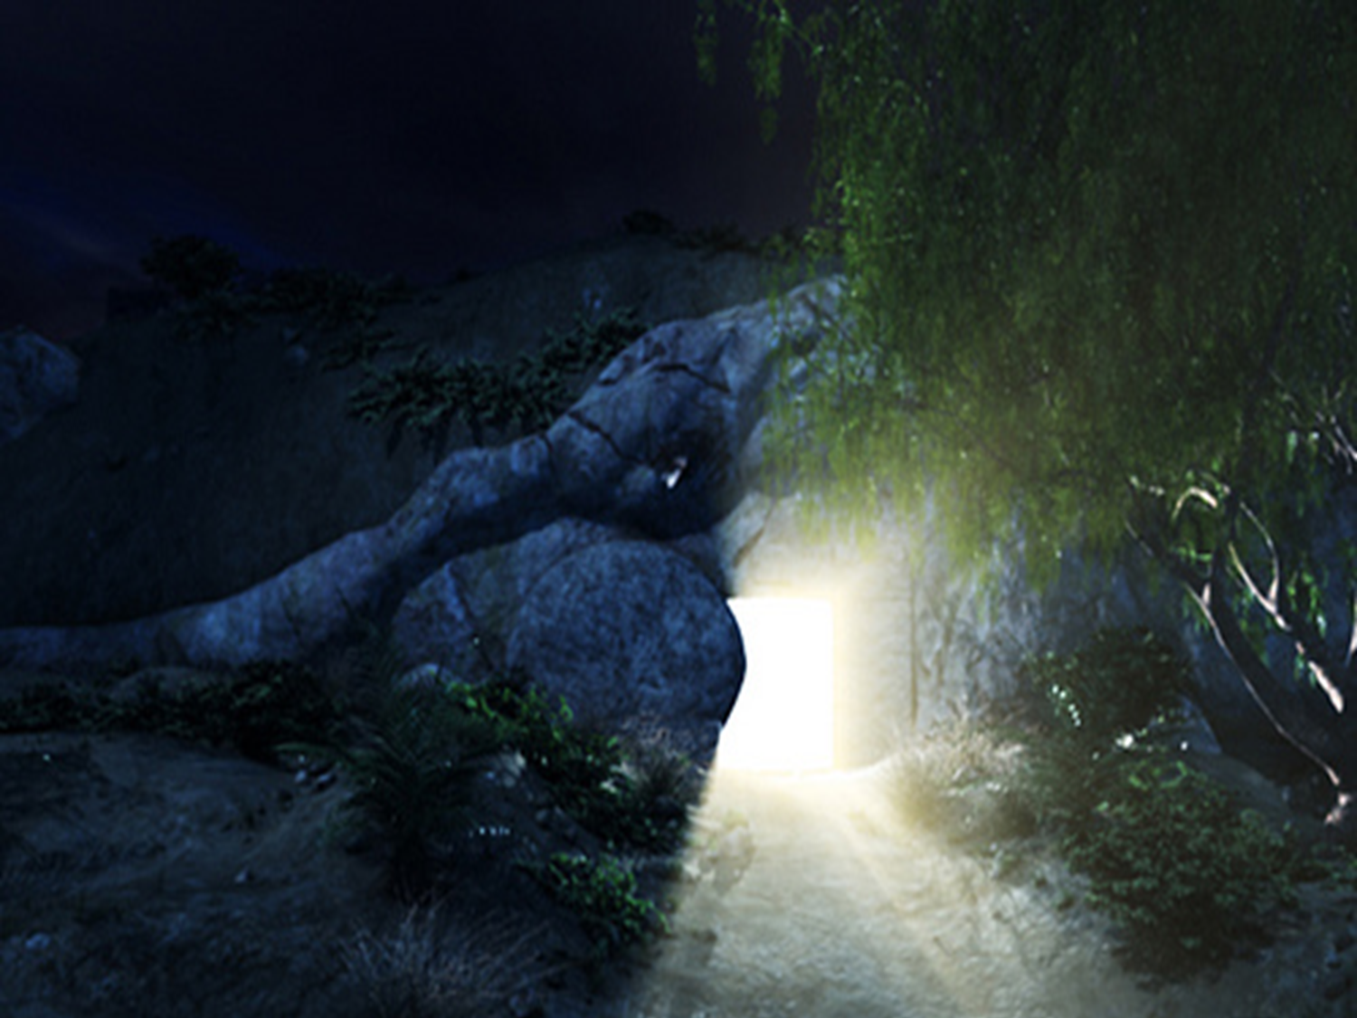
Isaiah 53
4 Surely He has borne our griefs
And carried our sorrows;
Yet we esteemed Him stricken,
Smitten by God, and afflicted.
5 But He was wounded for our transgressions,
He was bruised for our iniquities;
The chastisement for our peace was upon Him,
And by His stripes we are healed.
6 All we like sheep have gone astray;
We have turned, every one, to his own way;
And the LORD has laid on Him the iniquity of us all.

Slide 3
1 Corinthians 11
23 For I received from the Lord that which I also delivered to you: that the Lord Jesus on the same night in which He was betrayed took bread;
24 and when He had given thanks, He broke it and said, “Take, eat, this is My body which is broken for you; do this in remembrance of Me.” 25 In the same manner He also took the cup after supper, saying, “This cup is the new covenant in My blood. This do, as often as you drink it, in remembrance of Me.”
26 For as often as you eat this bread and drink this cup, you proclaim the Lord’s death till He comes.

Slide 4
505 – Glorify Thy Name
Handout – Worthy, You Are Worthy
Opening Prayer
162 – Night, With Ebon Pinion
S-57 – Thank You, Lord
Handout – In Christ Alone
Sermon
326 – Trust And Obey
678 – If We Never Meet Again

Slide 5
“The Way Things Were”

Slide 6
Philippians 4:8,9
“Finally, brethren, whatever things are true, whatever things are noble, whatever things are just, whatever things are pure, whatever things are lovely, whatever things are of good report, if there is any virtue and if there is anything praiseworthy—meditate on these things. 9 The things which you learned and received and heard and saw in me, these do, and the God of peace will be with you.”

Slide 7
“We Have A Strong Tendency To Reconstruct The Past”

Slide 8
Proverbs 16:2
“All the ways of a man are pure in his own eyes, But the Lord weighs the spirits.”

Slide 9
Isaiah 43:25
“I, even I, am He who blots out your transgressions for My own sake; And I will not remember your sins.

Slide 10
Jeremiah 14:10
“Thus says the Lord to this people:
“Thus they have loved to wander;
They have not restrained their feet.
Therefore the Lord does not accept them; He will remember their iniquity now, And punish their sins.”

Slide 11
Hebrews 8:12
“For I will be merciful to their unrighteousness, and their sins and their lawless deeds I will remember no more.”

Slide 12
“When We Have A Wrong View Of The Past We Will Not See The Present ”

Slide 13
Matthew 23:29-36
“Woe to you, scribes and Pharisees, hypocrites! Because you build the tombs of the prophets and adorn the monuments of the righteous, 30 and say, ‘If we had lived in the days of our fathers, we would not have been partakers with them in the blood of the prophets.’ 31 “Therefore you are witnesses against yourselves that you are sons of those who murdered the prophets. 32 Fill up, then, the measure of your fathers’ guilt. 33 Serpents, brood of vipers! How can you escape the condemnation of hell?

Slide 14
Matthew 23:29-36
34 Therefore, indeed, I send you prophets, wise men, and scribes: some of them you will kill and crucify, and some of them you will scourge in your synagogues and persecute from city to city, 35 that on you may come all the righteous blood shed on the earth, from the blood of righteous Abel to the blood of Zechariah, son of Berechiah, whom you murdered between the temple and the altar. 36 Assuredly, I say to you, all these things will come upon this generation.

Slide 15
“Memory”
Why did they view themselves as grasshoppers ready to be killed?
“Then the Lord said: “I have pardoned, according to your word; 21 but truly, as I live, all the earth shall be filled with the glory of the Lord— 22 because all these men who have seen My glory and the signs which I did in Egypt and in the wilderness, and have put Me to the test now these ten times, and have not heeded My voice, 23 they certainly shall not see the land of which I swore to their fathers, nor shall any of those who rejected Me see it.” – Numbers 14

Slide 16
“The Power Of A God-Centered Memory”

Slide 17
“God In Our Lives”
We cannot remember until we see God’s hand in our lives. (Rom 1:20-22)
“For since the creation of the world His invisible attributes are clearly seen, being understood by the things that are made, even His eternal power and Godhead, so that they are without excuse, 21 because, although they knew God, they did not glorify Him as God, nor were thankful, but became futile in their thoughts, and their foolish hearts were darkened. 22 Professing to be wise, they became fools,”

Slide 18
Hebrews 4:14-16
“Seeing then that we have a great High Priest who has passed through the heavens, Jesus the Son of God, let us hold fast our confession. 15 For we do not have a High Priest who cannot sympathize with our weaknesses, but was in all points tempted as we are, yet without sin. 16 Let us therefore come boldly to the throne of grace, that we may obtain mercy and find grace to help in time of need.”

Slide 19
Hebrews 12:3
“For consider Him who endured such hostility from sinners against Himself, lest you become weary and discouraged in your souls.”
“If only we could see the cross every time we thought of quitting, striking back, compromising or becoming indifferent”

Slide 20
“Principles To Mold Our Memories”

Slide 21
“Molding Our Memory”
Challenge the things you remember. (Jn 7:24)
Learn to not forget the what God tells us, and do forget the things He says to. (Eph. 4:17-32)
Remember the stand of faithful men and women who stands in our own life. (Heb. 10:32-35)

Slide 22
Conclusion

Slide 23
Conclusion
Does the peace and joy of God reign in your life?
‘Therefore gird up the loins of your mind, be sober, and rest your hope fully upon the grace that is to be brought to you at the revelation of Jesus Christ;’ – 1 Peter 1:13
What do you remember?

Slide 24
Philippians 4:6-9
‘Be anxious for nothing, but in everything by prayer and supplication, with thanksgiving, let your requests be made known to God; 7 and the peace of God, which surpasses all understanding, will guard your hearts and minds through Christ Jesus. 8 Finally, brethren, whatever things are true, whatever things are noble, whatever things are just, whatever things are pure, whatever things are lovely, whatever things are of good report, if there is any virtue and if there is anything praiseworthy—meditate on these things. 9 The things which you learned and received and heard and saw in me, these do, and the God of peace will be with you.’

Slide 25
“The Way Things Were”

Slide 26
“The Lions
Lunch”

