Slide 1
The End Of The World

Slide 2
Introduction
Predictions of the end of the world are not new. Case in point, in the 1st century, some affirmed boldly that the Lord had already returned (2 Timothy 2:17-18).
Some in today’s religious world still hold to this doctrine by teaching that everything the Bible says about the end has already occurred.
So the question that is many times raised regarding our life and world today... “Is this heaven or is it hell?”

Slide 3
The Bible discloses that the end could come at any time; there are no Biblical prophecies which remain undone, save the return of Christ for the judgment of all souls, then comes eternity.
Writing to the Thessalonians, Paul equipped them with the mind that the Lord could return at any moment (1 Thessalonians 4:15-17; 5:1-6).
Paul did not teach them (nor did any other Bible writer) about a tribulation, rapture and/or a millennial reign as is universally taught today.

Slide 4
The Bible declares that the Lord will come again, but we do not and cannot know when He will return. There are no signs ...
^{Matthew 24:43} But know this, that if the master of the house had known what hour the thief would come, he would have watched and not allowed his house to be broken into. ⁴⁴ Therefore you also be ready, for the Son of Man is coming at an hour you do not expect.
^{Matthew 25:13} “Watch therefore, for you know neither the day nor the hour^{[b]} in which the Son of Man is coming.
^{2 Peter 3:10} But the day of the Lord will come as a thief in the night, in which the heavens will pass away with a great noise, and the elements will melt with fervent heat; both the earth and the works that are in it will be burned up.

Slide 5
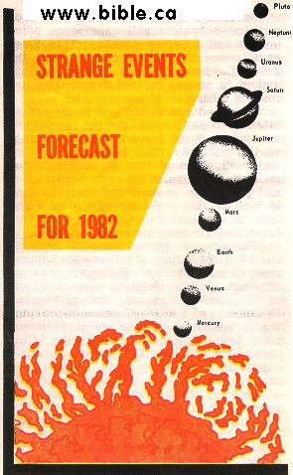
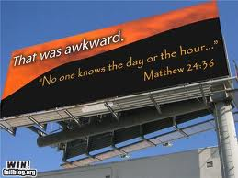
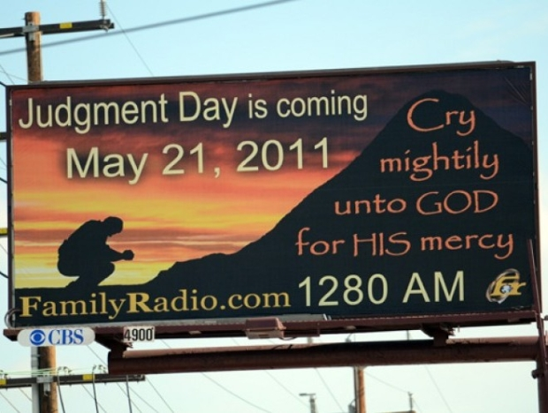
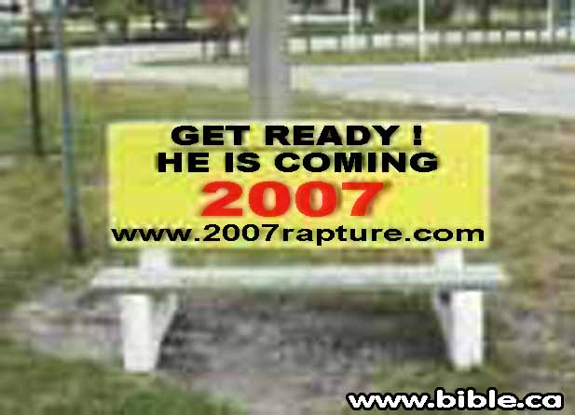

Slide 6
There are repeat offenders at setting a date which has come and gone without the prophesied end happening; 1914, 1918, 1920, 1925, 1941, 1975, 1994. ...
What explanation do they give for these failed prophecies? Simply that new light has come, things are becoming clearer, etc..
How does a line of false prophecies show a move toward truth?
They could (and likely will) be wrong every time they set a date.
Remember, Jesus said that no one knows, not even the Son (Mark 13:32).

Slide 7
According to Camping, a 23 year tribulation period (of which the Bible says nothing about) commenced on May 21, 1988, which will end with the rapture (which the Bible says nothing about) on May 21, 2011.
Then the earth will be destroyed five months later, on October 21, 2011. His explanation for the date is filled with more misinformation and rhetoric than a political campaign.
He manufactures dates for the creation (11,023 BC), flood (4,990 BC), and Jesus’ birth, (7 BC) and then infers his conclusions by pulling together a set of verses that have no connection to one another except in Camping’s mind.
There is no evidence provided in supporting his timeline.

Slide 8
His basic premise is this:
Genesis 7:4 has a twofold meaning (which the Bible does not say). Not only was God telling Noah that seven days remained before the earth would be destroyed by the flood, but he was also saying that the earth would continue for 7,000 more years.
To establish this, he draws from 2 Peter 3:8 (a day is as a thousand years to the Lord).
So, 7,000 years after the arbitrary date for the flood, apparently the Lord’s return (in the context of 2 Peter 3) would come.

Slide 9
In the same context, Peter, writing to his contemporaries, urged them to look for the coming of the Lord (2 Peter 3:12).
In his first epistle, again to his contemporaries, Paul wrote, “the end of all things is at hand” (1 Peter 4:7).
Peter expected the Lord’s return, not some 1900 years in the future, but possibly in his own time. He did not know when the Lord would return (no Bible writer knew, nor does the Lord Jesus know).
Does Mr. Camping claim to know something that was kept from Jesus and His apostles?

Slide 10
Is 2 Peter 3:8 given as a warning about the coming of Christ right to the very day?
Remember, Jesus said no one knows. It will come as a thief in the night.
Peter simply revealed that God is not governed by time as we are.
It is not a calendar to be linked together with Genesis 7:4, rather it is an encouragement for faithful service at all times, for we do not know when the Lord will return.

Slide 11
Conclusion
Are we continuing steadfast, unmovable always abounding in the work of the Lord?
Are we going to be faithful no matter what day or time it is?
Live as if it were the last day…
Are we prepared?

