Slide 2
Spiritual
Oomph

Slide 3
Colossian 3:23
“And whatever you do, do it heartily, as to the Lord and not to men,”

Slide 4
1 Thess. 5:16
“Rejoice always”

Slide 5
1 Thess. 5:17
“Pray without ceasing”

Slide 6
Ephesians 4:3
“endeavoring to keep the unity of the Spirit in the bond of peace.”

Slide 7
Romans 12:11
“not lagging in diligence, fervent in spirit, serving the Lord;”

Slide 8
Colossians 4:12
“Epaphras, who is one of you, a bondservant of Christ, greets you, always laboring fervently for you in prayers, that you may stand perfect and complete in all the will of God.”

Slide 9
Mark 4:18,19
“Now these are the ones sown among thorns; they are the ones who hear the word, 19 and the cares of this world, the deceitfulness of riches, and the desires for other things entering in choke the word, and it becomes unfruitful.”

Slide 10
Ridding of worry

Slide 11
1 Peter 5:8
“Be sober, be vigilant; because your adversary the devil walks about like a roaring lion, seeking whom he may devour.”

Slide 12
“Get busy on the next required action in our life!”

Slide 13
Mental Traffic
Jams

Slide 14
Matthew 6:25
“Therefore I say to you, do not worry about your life, what you will eat or what you will drink; nor about your body, what you will put on. Is not life more than food and the body more than clothing?

Slide 15
Ephesians 4:14
“that we should no longer be children, tossed to and fro and carried about with every wind of doctrine, by the trickery of men, in the cunning craftiness of deceitful plotting,”

Slide 16
Colossians 1:23
“if indeed you continue in the faith, grounded and steadfast, and are not moved away from the hope of the gospel which you heard, which was preached to every creature under heaven, of which I, Paul, became a minister.”

Slide 17
Resolve
The Bugging Issues

Slide 18
“Does it bug us that we haven’t read our Bible?”

Slide 19
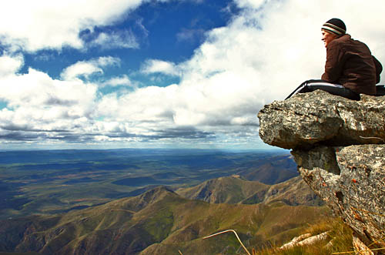
View from
a different height

Slide 20
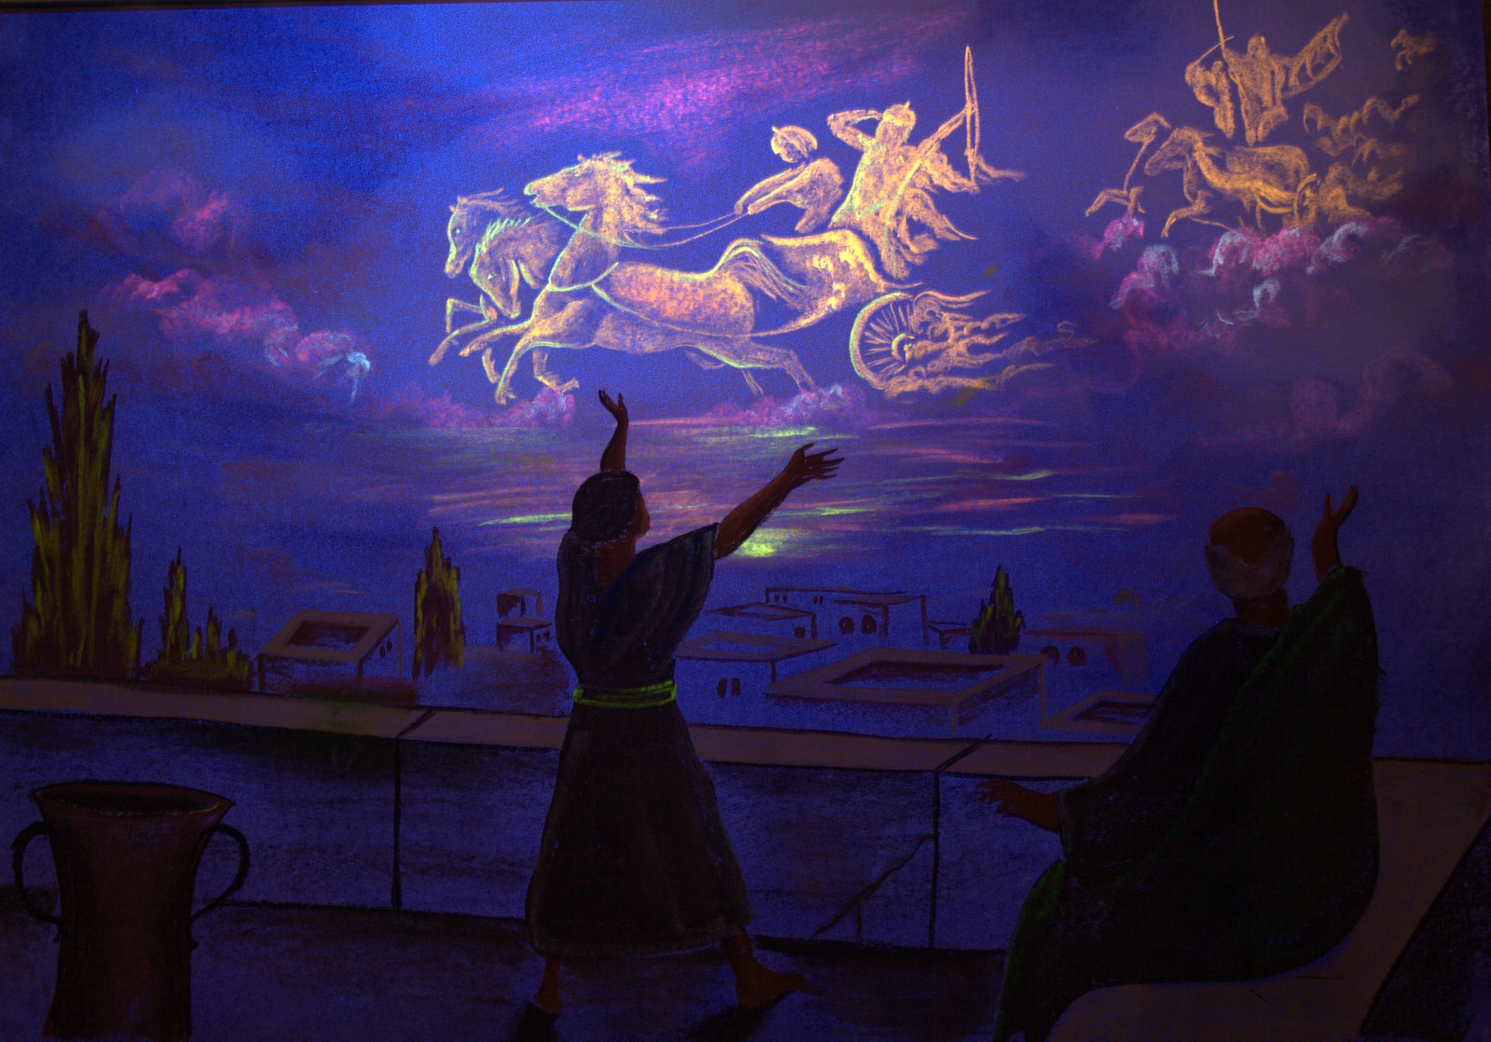

Slide 21
2 Kings 6:16
“Do not fear, for those who are with us are more than those who are with them”

Slide 22
Romans 8:31
“If God is for us, who is against us?”

Slide 23
“The 50,000 FT View”
I am a child of God!
If I die today I go to heaven (Philippians 1:21-23).
I have every spiritual blessing in Christ (Ephesians 1:3).

Slide 24
“The 50,000 FT View”
It is not too late for me like the rich man in Luke 16.
I have the truth!
I have the answers to my questions, and solves my big problems (2 Timothy 3:16-17).

Slide 25
“The 50,000 FT View”
I actually know who I am, where I am going, and why I am here (Acts 17:26-28).
There are so many problems, issues and other things that I do not have to deal with because I am obedient to God.

Slide 26
Mental Garage
Sale

Slide 27
“80 percent of everything in every drawer in our homes never gets used, and in like manner there are a number of mental thoughts and images that we need to discard.”

Slide 28
2 Corinthians 7:1
“Let us cleanse ourselves from all defilement of flesh and spirit”

Slide 29
2 Corinthians 10:5
“We are destroying speculations and every lofty things raised up against the knowledge of God, and we are taking every thought captive to the obedience of Christ”

Slide 30
Conclusion

Slide 31
Galatians 2:20
“I have been crucified with Christ; it is no longer I who live, but Christ lives in me; and the life which I now live in the flesh I live by faith in the Son of God, who loved me and gave Himself for me.”

Slide 32
Hebrews 13:5
“Let your conduct be without covetousness; be content with such things as you have. For He Himself has said, “I will never leave you nor forsake you.”

Slide 33
Galatians 6:9
“And let us not grow weary while doing good, for in due season we shall reap if we do not lose heart.”

Slide 34
Philippians 4:13
“I can do all things through Christ who strengthens me.”

Slide 35
Philippians 4:11
“Not that I speak in regard to need, for I have learned in whatever state I am, to be content:”

Slide 36
Ecclesiastes 12:13,14
“Let us hear the conclusion of the whole matter: Fear God and keep His commandments, for this is man’s all. 14 For God will bring every work into judgment, including every secret thing, whether good or evil.”

Slide 37
Philippians 1:6
“being confident of this very thing, that He who has begun a good work in you will complete it until the day of Jesus Christ;”

Slide 38
Ecclesiastes 9:18
“Wisdom is better than weapons of war; But one sinner destroys much good.”

Slide 39
Matthew 10:42
“And whoever gives one of these little ones only a cup of cold water in the name of a disciple, assuredly, I say to you, he shall by no means lose his reward.”

Slide 40
2 Corinthians 4:16
“Therefore we do not lose heart. Even though our outward man is perishing, yet the inward man is being renewed day by day.”

Slide 41
“Tune Up”
“Are we experiencing a mental traffic jam?”
“Do we have some “bug” issues that we need to resolve?”
“Do we have a 10,000 foot view of things?”
“Do we need to have a mental garage sale?”

Slide 42
Spiritual
Oomph

