Slide 1
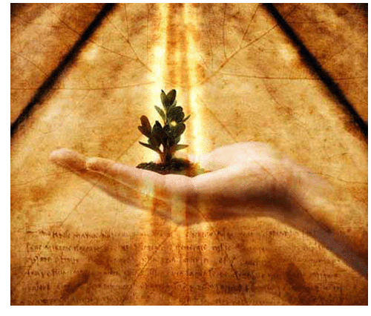
“Spiritual Hydrology”

Slide 2
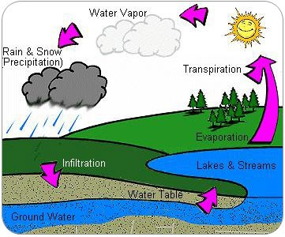
Introduction

Slide 3
The hydrological cycle is used by the prophet Isaiah to explain to us the working of God's word. Consider:
For as the rain comes down, and the snow from heaven, and do not return there, but water the earth and make it bring forth and bud, that it may give seed to the sower and bread to the eater, so shall My word be that goes forth from My mouth; it shall not return to Me void, but it shall accomplish what I please, and it shall prosper in the thing for which I sent it. (Isaiah 55:10-11)

Slide 4
The rain does not fall from the sky, just to rise right back to the clouds again.
It does not return until it has accomplished its work of watering the earth, renewing the water supply of our lakes and rivers, and keeping the land fertile and alive.
We would live on a dry and barren land if it were not for the hydrological cycle.
In fact, if the water cycle didn't work as it does, all life on the face of the earth would be at great risk.
Thanks be to God that He...
...makes His sun rise on the evil and on the good, and sends rain on the just and on the unjust. (Matthew 5:45)

Slide 5
Whether it was the age of the patriarchs, during the time of Moses, through the period of the prophets, or now in the New Testament age, God's word has come from above.
And, like the rain, He has sent His word for the benefit of man.

Slide 6
From The Mouth of God
Some will tell us that God speaks to them directly. (spirit-led)
In times past, God did speak directly to man, but Hebrews 1:1-2 tells us He now speaks through His Son.
The writer goes on to say that the word ...began to be spoken by the Lord, and was confirmed to us by those who heard Him (2:3)
These men recorded the Scriptures, as moved by the Holy Spirit (2 Peter 1:20-21).
In speaking of the Scriptures, Paul used the word theospneutos to describe it's origin - it is God breathed (2 Tim 3:16).

Slide 7
God's wisdom revealed to the world
(1 Corinthians 2:4-5). ⁴ “And my speech and my preaching were not with persuasive words of human^{[a]} wisdom, but in demonstration of the Spirit and” of power,
God does not whisper in the ear, but has given a written record which has endured through persecution and remains to this day. (1 Peter 1:22-25).

Slide 8
Shall Not Return Void
The water which falls to the earth does not return to the heavens until it has accomplished what God sent it to do.
The same is true of the word of God.
He has sent His word to save souls; and it will do just that. Consider the Living Word...
Being sown into the hearts of men (Luke 8:11-15),
The word of God will result in souls being saved (James 1:21).

Slide 9
Shall Not Return Void
Paul tells us the gospel is God's power to save mankind (Romans 1:16)
Peter says that all who obey it will discover "times of refreshing" (Acts 3:19).
¹⁹ Repent therefore and be converted, that your sins may be blotted out, so that times of refreshing may come from the presence of the Lord,

Slide 10
It Shall Prosper
If we receive the word of God and walk according to it, it will prosper in our lives.
But what does that mean?
Jesus said that if we will hear and believe, we will have everlasting life and will not come into judgment (John 5:24).
²⁴ “Most assuredly, I say to you, he who hears My word and believes in Him who sent Me has everlasting life, and shall not come into judgment, but has passed from death into life.

Slide 11
It Shall Prosper
How do we not come into judgment?
In another place, He identifies the word as the means by which all will be judged (John 12:48).
If we know the word and are obedient to it, indeed we will stand in judgment, however received into heaven.

Slide 12
When we open the door to God's word in our lives, we will be made more like God.
Jesus said that the word will sanctify us (John 17:17).
In Ephesians 5:26, we are pictured as the bride of Christ, "cleansed with the washing of water by the word."
As we allow for the word of God to dwell within us, it will become a fountain of life in us (John 4:14), able to overflow and affect those who are around us.

Slide 13
Hebrews 4:12 speaks of God's word as "living and powerful."
It is not dead and ineffective.
If we will allow it, the Bible, like a sword is able to prune the dead works out of our lives to make us better servants of the Lord (John 15:1-2).
¹ “I am the true vine, and My Father is the vinedresser. ² Every branch in Me that does not bear fruit He takes away;^{[a]} and every branch that bears fruit He prunes, that it may bear more fruit.

Slide 14
“Spiritually Prospering”
James reveals how the word can prosper in our lives in the very context where he says we must receive it with meekness so as to be saved (James 1:21).
We're told that God has brought us forth by the word, so that "we might be a kind of first-fruits of His creatures" (James 1:18).
Again, the writer tells us that we must be doers of the word, not just hearers. A promise is made to the doer:
...he who looks into the perfect law of liberty and continues in it, and is not a forgetful hearer but a doer of the work, this one will be blessed in what he does. (James 1:25)

Slide 15
Conclusion
May we realize how truly blessed we can be with God's word in our lives.
It is the word of life - the voice of God to His creation in order that we might be made right & ready for eternity in heaven.
Let us heed unto the voice of God!
Let His Word dwell in us and prosper in our lives!

