Slide 1
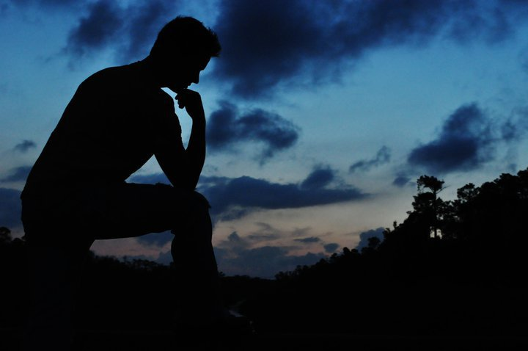
“Out Of The Depths”

Slide 2
"How do we deal with guilt?
One way is by denial.
We simply refuse to admit its existence.
Another way is through rationalization.
We admit that we are guilty, but we immediately blunt the edge of our confession by pointing out all of the extenuating circumstances that have conspired to make us this way.

Slide 3
Another way to deal with guilt is by… relativization.
We simply point out that everyone else is thinking or doing exactly what we are, and that we aren't so bad. When we find worse examples than ourselves, it makes us look better. By this we also take the spotlight off ourselves and put it on someone else, much to our relief.
There is another way to deal with guilt, however, and this way gets to its root. This is by admission, confession, and forgiveness...

Slide 4
I. The Cry From The Depths
130:1 "Out of the depths I have cried to Thee, O Lord":
The depths are eloquent enough in themselves as a figure of near despair... with the victim's sense of floundering and terror. What is clear in all such passages is that self-help is no answer to the depths of distress, however useful it may be in the shallows of self-pity" (Derek Kidner, Psalms 73-150, p. 446).

Slide 5
"In the Hebrew being in 'the depths' refers specifically to being caught in dangerous and deep waters" (James Montgomery Boice, Psalms 107-150, pp. 1138-1139).
What has overwhelmed the writer is not some sort of external trial, persecution or suffering, rather, he is overwhelmed by the guilt of his own sins.
Such language also infers that there is not any earthly way to get out of this pit. We cannot save ourselves, and even human help in the form of such things as secular counseling cannot completely remove our guilt.

Slide 6
"Our problem today, especially in appreciating a psalm like this, is that most of us do not have much awareness of sin. We live most of our lives with very little awareness of God, and where God has been abolished an awareness of sin is inevitably abolished also... We need to recover a sense of sin. We need to discover how desperate our condition is apart from God. We need to know that God's wrath is not an outmoded theological construct but a terrible and impending reality (Matthew 10:28). We need to come out of our sad fantasy world and begin to tremble before the awesome holiness of our almighty Judge (Isaiah 6:1ff)" (Boice p. 1139).

Slide 7
130:2
Here we learn that being serious about being forgiven is when we start crying out to God for help.
"Where do we turn when we are in the depths? We can seek to medicate the pain through drugs or alcohol. We can surrender to the pain and sink into the darkness of depression, or we can cry out to God" (Williams p. 439).

Slide 8
II. The Confession
130:3 "If Thou, Lord, shouldst mark iniquities, O Lord, who could stand?"
The word "mark" means to "keep account of".
If God should simply keep track of all our sins and refuse to forgive, then our account would become so lopsided that our punishment would be certain and immediate.
Are we thankful that the God who exists is a God who is willing to forgive? Rom. 3:23, 6;23

Slide 9
130:4 "But there is forgiveness with Thee, that Thou mayest be feared"
"But": We may not find forgiveness with others or even family, and some people find it extremely difficult to forgive even themselves.
What wonderful news that God is both able and willing to forgive.
"Verse 4 is notable, too, for its second line, that Thou mayest be feared, which may sound a strange outcome of forgiveness.

Slide 10
Consider how a godly man reacts to such forgiveness.
He doesn't say, "Oh well, if I sin again, God will forgive me, so why take sin so seriously?"
If a person truly has repented and they truly appreciate their forgiveness, then such forgiveness will lead to only a heightened respect for God and His Word.

Slide 11
"The true and inevitable effects of forgiveness are love, worship and service. By these effects you can measure whether you have actually confessed your sin, believed on God, and been forgiven, or are merely presuming on forgiveness without any genuine repentance or faith. Those who have been forgiven are softened and humbled and overwhelmed by God's mercy, and they determine never to sin against such a great and fearful goodness" (Boice p. 1142).
The essence of true religion has to do with a holy reverence of God (Isaiah 66:2; Micah 6:8).

Slide 12
Applications
•"The forgiveness we are talking about does not lead to license, as some suppose, but to a heightened reverence for God" (Boice p. 1141).
•We might think that the verse should read, "There is forgiveness with Thee that Thou mayest be loved".
This might make sense until we remember that Biblical fear "has to do with a holy reverence of God that is the essence of true religion.

Slide 13
III. Waiting for the Lord
130:5 "It is the Lord Himself, not simply escape from punishment, for which the writer longs.
Notice that such waiting is grounded in the promises and instruction revealed in the Scriptures. The Bible tells us that God is merciful, willing to forgive, and explains just how and when we can be forgiven.

Slide 14
130:6 The writer eagerly waits with great anticipation for God's salvation.
He is like the watchman who waits to be released from duty at the dawning of a new day.
Today some people claim to be "waiting on the Lord", but what they are really waiting for is some type of mystical feeling.
When we wait on the Lord, we are only waiting for what has been revealed in His Word.
To expect something that God has not promised - fails to qualify as waiting on the Lord, because waiting on God is all about trusting His way of doing things (Romans 10:17).

Slide 15
IV. Trust God Also
130:7-8
Having found forgiveness the writer is now able to focus on other people and their need for God's mercy.
He encourages the nation to place their trust in God.

Slide 16
Therefore, put your trust in this God!
This writer could not really help or encourage anyone else until he repented of his own sins and sought forgiveness (Psalm 32).
Here is motivation to clean up our own lives, for guilt is something that will prevent us from being much help to others.
We really cannot help other people much until we take care of our own sins first.

Slide 17
Conclusion
Do we trust the Lord?
What is our level of reverence toward God?
Does it need to be heightened?
Are we showing our love through our worship and service unto the Lord?

Slide 18
Psalm 130
1 Out of the depths have I cried unto thee, O Lord.
2 Lord, hear my voice; let thine ears be attentive to the voice of my supplications.
3 If thou, Lord, shouldest mark iniquities, O Lord, who shall stand?
4 But there is forgiveness with thee, that thou mayest be feared.
5 I wait for the Lord, my soul doth wait, and in His word do I hope.

Slide 19
Psalm 130
6 My soul waiteth for the Lord more than they that watch for the morning; I say more than they that watch for the morning.
7 Let Israel hope in the Lord; for with the Lord there is mercy and with Him is plenteous redemption.
8 And He shall redeem Israel from all his iniquities.

