Slide 1
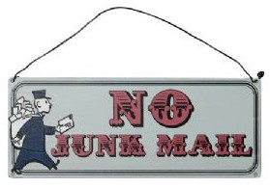
“No Junk Mail”

Slide 2
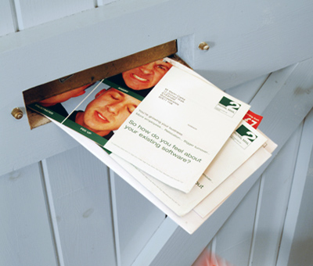

Slide 3
However, one preacher was always delighted to see the signs which read, "No Junk Mail," and always left a flyer or invitation.
The preacher recalled that on more than one occasion he received a phone call from an angry resident, complaining that a flyer inviting them to study the Bible was left at their door when they clearly have a "No Junk Mail" sign posted.
The preacher’s reply was quite simple - an invitation to study God's word is not junk.
The complainant may not appreciate the wonderful opportunity which has been offered, but that does not constitute it as "junk".
JUNK ...something of poor quality: trash; something of little meaning, worth or significance... _{(Merriam-Webster.com)}

Slide 4
If the offer were free gasoline, free pizza, or an all expenses paid vacation, I doubt we'd hear any complaint.
Such things appeal to the flesh; to the earthly mind they are tangible and of great value. But an offer to study the Bible - what value is there in that?
Jesus taught His disciples about the value of the kingdom of God in a pair of kingdom parables. He said:
Again, the kingdom of heaven is like treasure hidden in a field, which a man found and hid; and for joy over it he goes and sells all that he has a buys that field. Again, the kingdom of heaven is like a merchant seeking beautiful pearls, who, when he has found one pearl of great price, went and sold all that he had and bought it. - (Matthew 13:44-46)

Slide 5
The universal appeal of great treasure, whatever it may be, is an exceptional way to describe the kingdom of God!
The one who comprehends the true value of the kingdom of heaven is willing to give up all else in order to receive it. (Matthew 10:37-39; Philippians 3:7-11).
The treasures once yearned for fade in significance; our focus begins to turn to the "...prize of the upward call of God in Christ Jesus." (Philippians 3:14).
The apostle refers to the former things as "rubbish" (NKJV) or "refuse" (ASV) in contrast to "...the excellency of the knowledge of Christ Jesus..." (Philippians 3:8).

Slide 6
However, until one is willing to consider the word of God, the treasure remains obscured, its value hidden.
Jesus spoke a parable about a sower who indiscriminately scattered seed on various types of soil (Matthew 13:3-9).
The seed which fell on the wayside (path, road) could not germinate.
In explaining the parable, Jesus said of this soil,
“When anyone hears the word of the kingdom and does not understand it, then the wicked one comes and snatches away what was sown in his heart. This is he who received seed by the wayside.” (Matthew 13:3-9)

Slide 7
A Lesson For Today
This will be exhibited in a variety of ways, from a friendly, "I'm not interested" to harsh and explicit words, perhaps even violence.
We should not allow the potential results deter us from sowing the seed.
We cannot know whether the soil is good or not until the seed has touched it.
Finally, there is hope. Though one has rejected the gospel today, so long as there is breath, there is life, and the opportunity to obey the Lord.

Slide 8
Conclusion
The soil can change.
Through the circumstances of life, what once was a piece of "junk mail" may be perceived in the future as a treasure map, leading a lost soul to the truth of God's word.
Do not be discouraged - share the word with friends, family, co-workers, neighbours, and strangers alike.
Sow the seed!

Slide 9
