Slide 1
“Name It & Claim It”

Slide 2
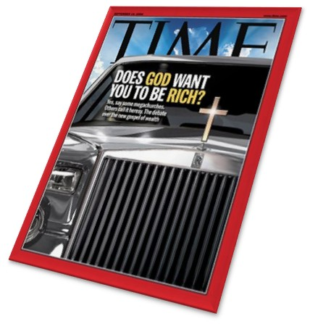

Slide 3
Joel Osteen assures his readers and followers that...
“God wants us to prosper financially, to have plenty of money, to fulfill the destiny He has laid out for us.”
He preaches a "name it and claim it" gospel; turning Christianity into a religion about temporal happiness rather than devoted service to the God of heaven in hope of eternal life. He tells us that...
“If we say it long enough eventually we're going to reap a harvest. We're going to get exactly what we're saying.”

Slide 4
Again, he tells us...
“If you develop an image of success, health, abundance, joy, peace, happiness - nothing on earth will be able to hold those things from you.”
Such things appeal to the flesh...
Prosperity preaching is based in a misuse of a few Bible texts, and an utter disregard of several more.
It teaches self-interest, not selflessness.
It emphasizes materialism, not spiritual things.

Slide 5
“I marvel that you are turning away so soon from Him who called you in the grace of Christ, to a different gospel, which is not another; but there are some who trouble you and want to pervert the gospel of Christ.” - (Galatians 1:6-7)
Men have perverted the gospel in a variety of ways through the ages.
In Paul's day, the Jewish Christians insisted that the Gentiles keep Moses' law (Acts 15:5).
Years later, the roots which would eventually result in men adding a overabundance of doctrines, grounded in human tradition, not in the word of God.
There have been several different “gospels” taught through the centuries, each one a perversion of the truth of God's word.

Slide 6
You will hear prosperity preachers say that God wants you to have "an abundant life." Indeed, Jesus said,
“I have come that they may have life, and that they may have it more abundantly.” (John 10:10)
Was Jesus promising His followers cars, vacation homes, boats, etc.?
The life which He gives is in contrast with the death and destruction that the thief causes (v 10).
Who is the thief? Is it not the devil?
Satan does not begrudge us prosperity in things of this world. He wanted Eve to have the fruit; he offered the nations to Jesus, and was happy for Judas to have 30 pieces of silver.

Slide 7
The abundant life which Jesus does not major in materialism. Matthew 6:25-34
He commanded the rich young ruler to sell what he had, for his material wealth stood between him and eternal life - (Matthew 19:16-22).
Another favourite text of the health and wealth folks is 2 Corinthians 8:9. There, we read,
“For you know the grace of our Lord Jesus Christ, that though He was rich, yet for your sakes He became poor, that you through His poverty might become rich.”
Paul encouraged the Corinthians to minister to the needs of others. There was no promise of wealth, but rather an acknowledgement that when they might be in need, others would minister to them (v 14).

Slide 8
Jesus became poor in that He dwelt as a man and died for our sins (Philippians 2:6-8).
We become rich in Him in faith, not in dollars and cents (2 Corinthians 6:4-10; James 2:5).
Finally, you may hear prosperity proponents citing 3 John 2:
“Beloved, I pray that you may prosper in all things and be in health, just as your soul prospers.”
It was a greeting, nothing more or less.

Slide 9
If health & wealth are in a linear relationship to faith, then...
Timothy (1 Timothy 5:23),
Epaphroditus (Philippians 2:27), and others were not very faithful.
Paul suffered health issues.
He asked God to take it away, but He did not (2 Corinthians 12:7-10).

Slide 10
Conclusion
Osteen and his cohorts say "name it and claim it," making God their own personal Santa.
Paul named his thorn and God said "No.“
If Paul couldn't "name and claim," nor taught such - how dare any today?
It is another gospel, a perversion.
“¹⁰ For do I now persuade men, or God? Or do I seek to please men? For if I still pleased men, I would not be a bondservant of Christ.” – Galatians 1:10

