Slide 1
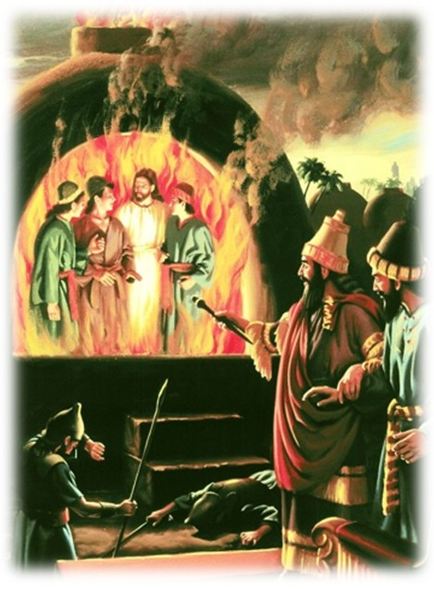
“I See Four Men”

Slide 2
Introduction
It was Nebuchadnezzar, king of Babylon who had a massive gold statue of himself.
Throughout the land, a proclamation was made, that upon hearing the symphony of music, all people should fall down and worship the graven image.
The warning was certain,
...whoever does not fall down and worship shall be cast immediately into the midst of a burning fiery furnace. (Daniel 3:6)

Slide 3
And so it was, when the horn, flute, harp and lyre sounded, the people would bow down and worship the statue of Nebuchadnezzar.
However, we find three men that were accused of not giving the king honour, Shadrach, Meshach, and Abed-Nego (Daniel 3:12).
They refused to bow unto the golden image and would not serve the Babylonian gods.

Slide 4
Infuriated, the king called for the young men to be brought before him. He graciously gave them an opportunity to mend their ways. But if they would not worship his image, the consequence would be the sentence of death by the fiery furnace.
Nebuchadnezzar would find that he was wasting his breath, for they, like Daniel, would not defile themselves with the things of Babylon (Daniel 1:8, 17-20).
These young men spoke to the king,
...our God whom we serve is able to deliver us from the burning fiery furnace, and He will deliver us from your hand, O king. But if not, let it be known to you, O king, that we do not serve your gods, nor will we worship the god image which you have set up. (Daniel 3:17-18)

Slide 5
They acknowledged that He could, but did not know if He would save them from the furnace.
But even if He did not, that would not alter their devotion to Him or confidence in His goodness.
Nebuchadnezzar was livid at these young men already, but now his wrath climaxed. He had the furnace heated seven times more than it was usually heated.
The king had his mighty men of valor bind the three Hebrews and cast them into the furnace. The fire had been kindled so hot, the men who cast them in died from the heat.

Slide 6
The King Is Astonished!
As he looked into the furnace he saw:
...four men loose, walking in the midst of the fire; and they are not hurt, and the form of the fourth is like the Son of God. (Daniel 3:25)

Slide 7
The three Hebrews came out of the fire, unscathed, not a hair or a thread singed, and no smell of the fire on them.
The king then proclaimed,
Blessed be the God of Shadrach, Meshach, and Abed-Nego, who sent His Angel and delivered His servants who trusted in Him, and they have frustrated the king’s word, and yielded their bodies, that they should not serve nor worship any god except their own God! (Daniel 3:28)
The king went on to decree that destruction would come upon anyone who spoke against the Hebrew God,
...for there is no other God who can deliver like this. (29)

Slide 8
A Lesson For Today
May we learn from Daniel’s friends that we should always trust in God, no matter how dire the circumstances.
These young men did not allow fear to guide their actions, rather it was faith! If anything other, then they would have bowed before the image and committed idolatry.
Many of the countrymen had done so; in fact it was the idolatry of Judah which brought them into captivity in Babylon.
It is important to stand for the faith, not to compromise in order to fit in or avoid punishment by those who are in power. (ex. John the Baptist)

Slide 9
Though Christians today are not being forced to worship idols, other challenges exist.
We, like John, must still stand for God’s plan for marriage (one man, one woman, for life).
We, like many prophets & apostles, must still oppose worldly things.
We, like Paul, must still stand against those who try to corrupt the church by leading people away from the word (none, not even an apostle or angel could change God’s word) Gal. 1.
We, like the apostle John, must stand firm against those who claim special knowledge (ie. Spirit-led).
Keep the faith; it will benefit you, and may affect those around you also.

Slide 10
Conclusion
2 Corinthians 4:16-18
“Therefore we do not lose heart. Even though our outward man is perishing, yet the inward man is being renewed day by day. ¹⁷ For our light affliction, which is but for a moment, is working for us a far more exceeding and eternal weight of glory, ¹⁸ while we do not look at the things which are seen, but at the things which are not seen. For the things which are seen are temporary, but the things which are not seen are eternal.”

