Slide 1
Handout – “My God Is Real”
S-38 – We Will Glorify
Opening Prayer
S-21 – Come, Share The Lord
372 – We Thank Thee, O Father
S-74 – My Eyes Have Seen Your Glory
Sermon
284 – What Will Your Answer Be?
430 – Take The Name Of Jesus With You

Slide 2
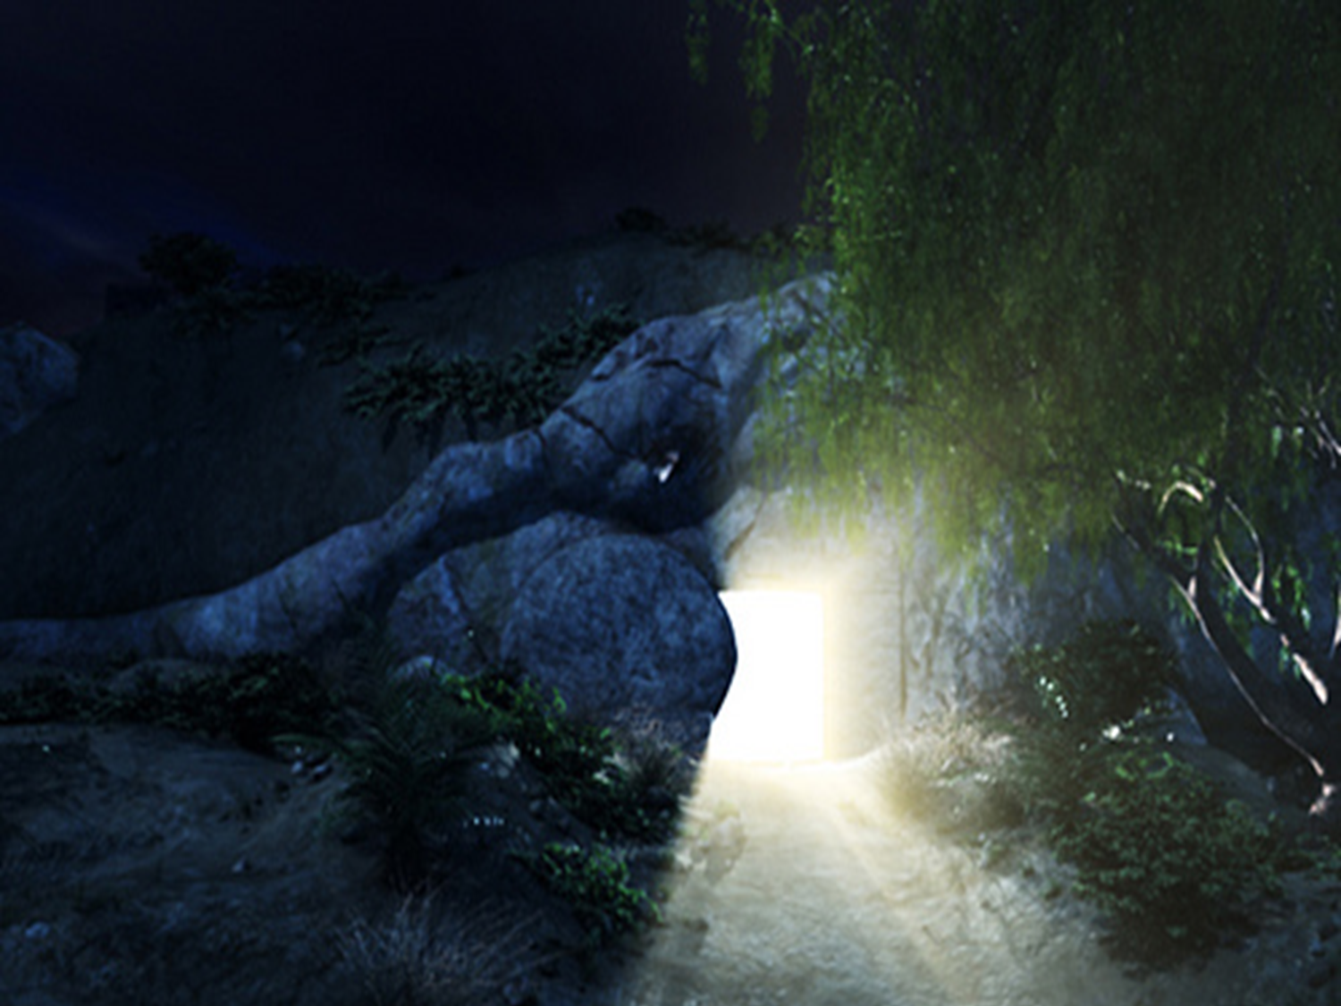
Isaiah 53
4 Surely He has borne our griefs
And carried our sorrows;
Yet we esteemed Him stricken,
Smitten by God, and afflicted.
5 But He was wounded for our transgressions,
He was bruised for our iniquities;
The chastisement for our peace was upon Him,
And by His stripes we are healed.
6 All we like sheep have gone astray;
We have turned, every one, to his own way;
And the LORD has laid on Him the iniquity of us all.

Slide 3
1 Corinthians 11
23 For I received from the Lord that which I also delivered to you: that the Lord Jesus on the same night in which He was betrayed took bread;
24 and when He had given thanks, He broke it and said, “Take, eat, this is My body which is broken for you; do this in remembrance of Me.” 25 In the same manner He also took the cup after supper, saying, “This cup is the new covenant in My blood. This do, as often as you drink it, in remembrance of Me.”
26 For as often as you eat this bread and drink this cup, you proclaim the Lord’s death till He comes.

Slide 4
Handout – “My God Is Real”
S-38 – We Will Glorify
Opening Prayer
S-21 – Come, Share The Lord
372 – We Thank Thee, O Father
S-74 – My Eyes Have Seen Your Glory
Sermon
284 – What Will Your Answer Be?
430 – Take The Name Of Jesus With You

Slide 5
“Now concerning the collection for the saints, as I have given orders to the churches of Galatia, so you must do also: 2 On the first day of the week let each one of you lay something aside, storing up as he may prosper, that there be no collections when I come.” – 1 Corinthians 16:1,2

Slide 6
Handout – “My God Is Real”
S-38 – We Will Glorify
Opening Prayer
S-21 – Come, Share The Lord
372 – We Thank Thee, O Father
S-74 – My Eyes Have Seen Your Glory
Sermon
284 – What Will Your Answer Be?
430 – Take The Name Of Jesus With You

Slide 7
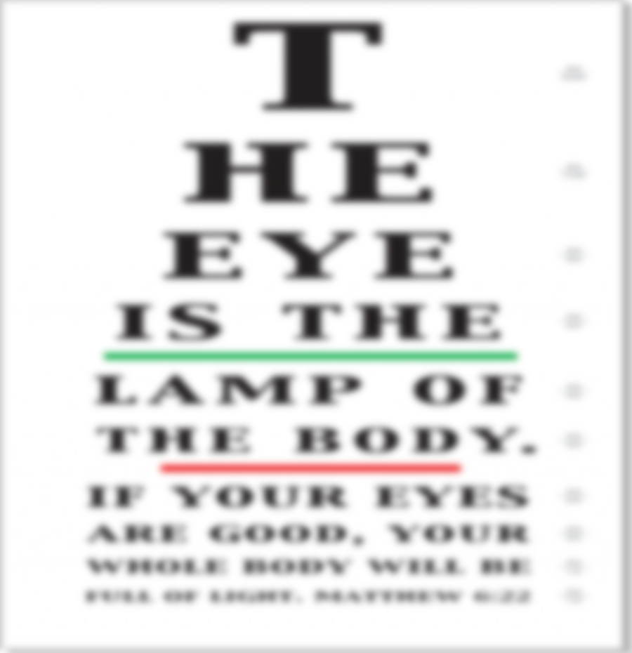

Slide 8
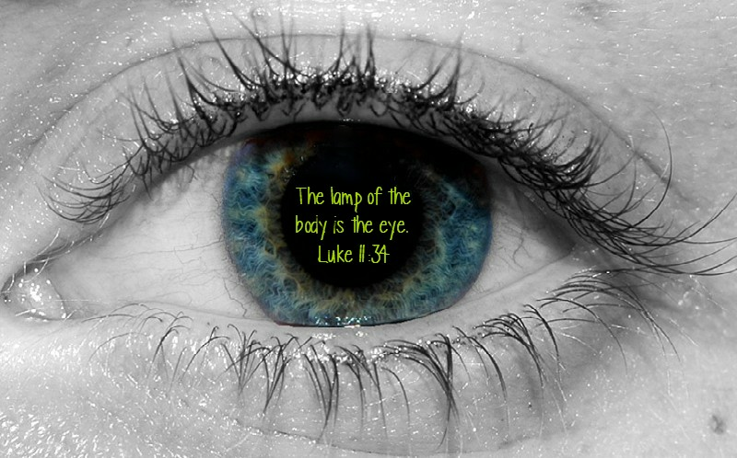
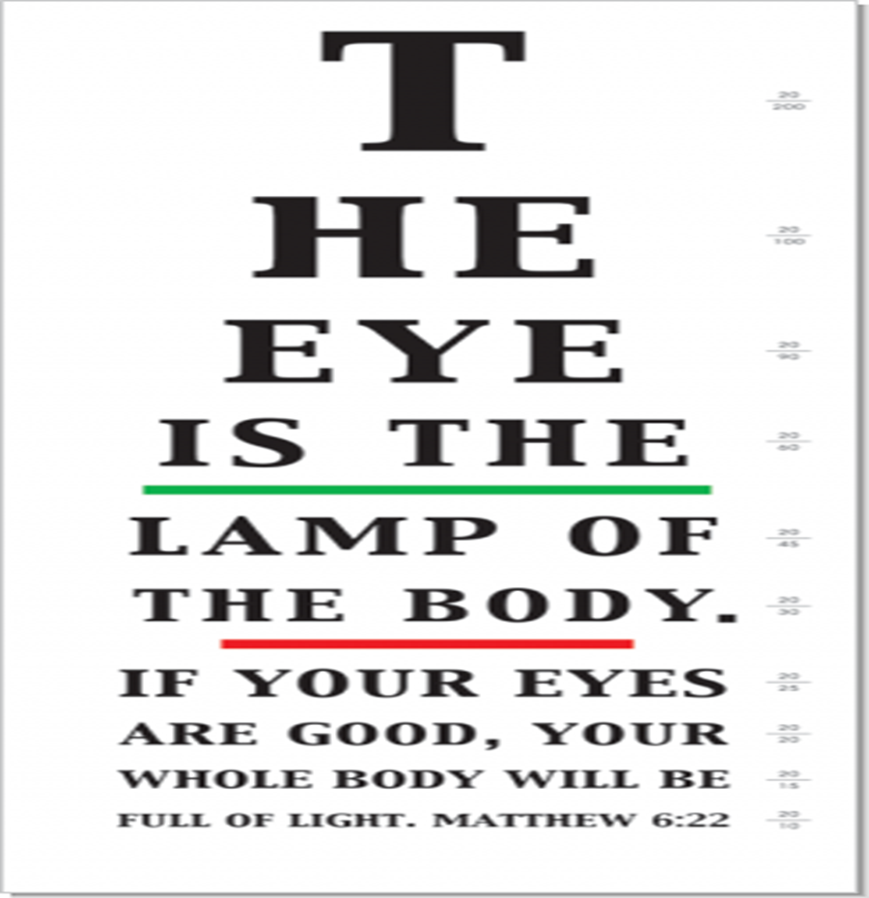

Slide 9
Good, Clear…
Vision

Slide 10
Matthew 13:14,15
And in them the prophecy of Isaiah is fulfilled, which says:
‘Hearing you will hear and shall not understand,
And seeing you will see and not perceive;
15 For the hearts of this people have grown dull.
Their ears are hard of hearing,
And their eyes they have closed,
Lest they should see with their eyes and hear with their ears,
Lest they should understand with their hearts and turn,
So that I should heal them.’

Slide 11
Luke 11:34
“The lamp of the body is the eye. Therefore, when your eye is good, your whole body also is full of light. But when your eye is bad, your body also is full of darkness.”

Slide 12
Our Eyes Must
Be
Focused On Heavenly Treasures

Slide 13
Matthew 6:19-23
“Do not lay up for yourselves treasures on earth, where moth and rust destroy and where thieves break in and steal; 20 but lay up for yourselves treasures in heaven, where neither moth nor rust destroys and where thieves do not break in and steal. 21 For where your treasure is, there your heart will be also.

Slide 14
Matthew 6:19-23
22 “The lamp of the body is the eye. If therefore your eye is good, your whole body will be full of light. 23 But if your eye is bad, your whole body will be full of darkness. If therefore the light that is in you is darkness, how great is that darkness!

Slide 15
We Must Open Our Eyes…
Believe Jesus and be saved from sin Jn. 9:35-41.
Be converted to Christ, Acts 26:18.
Have spiritual discernment, 1 Cor. 2:14-16.
Know the blessings we have from God Eph. 1:17-19.

Slide 16
We Must Have Spiritual Perception…
What is and is not, heavenly treasure. Matthew 6:19-20 (Matt. 13:44).
That our heart is where it should be. Matthew 6:21 (Col. 3:1-4).
Conduct which is pure and in truth. Matthew 6:22 (a “trained eye”, Lk. 6:40).

Slide 17
Matthew 6:33,34
“But seek first the kingdom of God and His righteousness, and all these things shall be added to you. 34 Therefore do not worry about tomorrow, for tomorrow will worry about its own things. Sufficient for the day is its own trouble.”

Slide 18
Raising The Level
of
Our Spiritual Perception

Slide 19
Eyes that see (know) the value of…
Lost Souls - Lk. 15:8-10.
How we see lost souls will determine our actions toward the lost.
The Truth of the Gospel - Prov. 23:23; Psa. 19:8, 10-11; 119:127-128
As we see the truth with spiritual eyes, we will lay it up in our hearts (Psa. 119:11); defend it (Phil. 1:17); contend for it (Jude 3); live it (Lk. 6:46).

Slide 20
Eyes that see (know) the value of…
Gospel Preaching - 1 Cor. 1:18-25; Rom. 10:8-17
Affects whether we want to listen to it; support it with our time, money, whole life, use it to save the lost.
The Church of Christ - 1 Tim. 3:15; Eph. 1:22-23; Eph. 3:21; Eph. 5:25-27
Affects how we treat her: Respect, love, concern, unity, honor, service; or with negligence, selfishness, pettiness, arrogance and boasting.

Slide 21
Eyes that see (know) the value of…
Heaven – Rev. 21:1
Affects whether being a devout Christian is most important to us.

Slide 22
Hebrews 11:13-16
These all died in faith, not having received the promises, but having seen them afar off were assured of them, embraced them and confessed that they were strangers and pilgrims on the earth. 14 For those who say such things declare plainly that they seek a homeland. 15 And truly if they had called to mind that country from which they had come out, they would have had opportunity to return. 16 But now they desire a better, that is, a heavenly country. Therefore God is not ashamed to be called their God, for He has prepared a city for them.

Slide 23
Hebrews 12:1,2
“Therefore we also, since we are surrounded by so great a cloud of witnesses, let us lay aside every weight, and the sin which so easily ensnares us, and let us run with endurance the race that is set before us, 2 looking unto Jesus, the author and finisher of our faith, who for the joy that was set before Him endured the cross, despising the shame, and has sat down at the right hand of the throne of God.”

Slide 25
God’s View

