Slide 2
Jonah 1:1-3
“Now the word of the Lord came to Jonah the son of Amittai, saying, 2 “Arise, go to Nineveh, that great city, and cry out against it; for their wickedness has come up before Me.” 3 But Jonah arose to flee to Tarshish from the presence of the Lord. He went down to Joppa, and found a ship going to Tarshish; so he paid the fare, and went down into it, to go with them to Tarshish from the presence of the Lord.”

Slide 3
351
“Will You Not Tell It Today”

Slide 4
2 Kings 5:1-15
“Now Naaman, commander of the army of the king of Syria, was a great and honorable man in the eyes of his master, because by him the Lord had given victory to Syria. He was also a mighty man of valor, but a leper. 2 And the Syrians had gone out on raids, and had brought back captive a young girl from the land of Israel. She waited on Naaman’s wife. 3 Then she said to her mistress, “If only my master were with the prophet who is in Samaria! For he would heal him of his leprosy.”

Slide 5
2 Kings 5:1-15
4 And Naaman went in and told his master, saying, “Thus and thus said the girl who is from the land of Israel.” 5 Then the king of Syria said, “Go now, and I will send a letter to the king of Israel.” So he departed and took with him ten talents of silver, six thousand shekels of gold, and ten changes of clothing. 6 Then he brought the letter to the king of Israel, which said, Now be advised, when this letter comes to you, that I have sent Naaman my servant to you, that you may heal him of his leprosy.

Slide 6
2 Kings 5:1-15
7 And it happened, when the king of Israel read the letter, that he tore his clothes and said, “Am I God, to kill and make alive, that this man sends a man to me to heal him of his leprosy? Therefore please consider, and see how he seeks a quarrel with me.”
8 So it was, when Elisha the man of God heard that the king of Israel had torn his clothes, that he sent to the king, saying, “Why have you torn your clothes? Please let him come to me, and he shall know that there is a prophet in Israel.”

Slide 7
2 Kings 5:1-15
9 Then Naaman went with his horses and chariot, and he stood at the door of Elisha’s house. 10 And Elisha sent a messenger to him, saying, “Go and wash in the Jordan seven times, and your flesh shall be restored to you, and you shall be clean.” 11 But Naaman became furious, and went away and said, “Indeed, I said to myself, ‘He will surely come out to me, and stand and call on the name of the Lord his God, and wave his hand over the place, and heal the leprosy.’

Slide 8
2 Kings 5:1-15
12 Are not the Abanah and the Pharpar, the rivers of Damascus, better than all the waters of Israel? Could I not wash in them and be clean?” So he turned and went away in a rage. 13 And his servants came near and spoke to him, and said, “My father, if the prophet had told you to do something great, would you not have done it? How much more then, when he says to you, ‘Wash, and be clean’?”

Slide 9
2 Kings 5:1-15
14 So he went down and dipped seven times in the Jordan, according to the saying of the man of God; and his flesh was restored like the flesh of a little child, and he was clean.
15 And he returned to the man of God, he and all his aides, and came and stood before him; and he said, “Indeed, now I know that there is no God in all the earth, except in Israel;

Slide 10
“Healing In Its Wings”

Slide 11
Exodus 3:1-22
Exodus 4:1-17

Slide 12
“Servant’s Song”

Slide 13
Genesis 12:1-4
“Now the Lord had said to Abram: “Get out of your country, from your family and from your father’s house, to a land that I will show you. 2 I will make you a great nation; I will bless you and make your name great; And you shall be a blessing. 3 I will bless those who bless you, and I will curse him who curses you; And in you all the families of the earth shall be blessed.” 4 So Abram departed as the Lord had spoken to him, and Lot went with him. And Abram was seventy-five years old when he departed from Haran.”

Slide 14
105
“I Am Thine, O Lord”

Slide 15
Matthew 28:18-20
“And Jesus came and spoke to them, saying, “All authority has been given to Me in heaven and on earth. 19 Go therefore and make disciples of all the nations, baptizing them in the name of the Father and of the Son and of the Holy Spirit, 20 teaching them to observe all things that I have commanded you; and lo, I am with you always, even to the end of the age.” Amen.

Slide 16
Acts 8:4
“Therefore those who were scattered went everywhere preaching the word”;

Slide 17
2 Timothy 2:2
“And the things you have heard from me before many witnesses, commit these to faithful men who are able to teach others also.”

Slide 18
“What is our response to
the directive….
?

Slide 19
“We Can…
Avoid It
Simply Not Do Our Part
Make Excuses

Slide 20
598
“You Never Mentioned Him To Me”

Slide 21
“Or We Can…
4. Obey…
not everyone has the same abilities, but everyone can do something to further the Gospel.

Slide 22
620
“Room In
God’s Kingdom”

Slide 23
1 Corinthians 15:58
“Therefore my beloved brethren, be steadfast, immovable, always abounding in the work of the Lord, knowing that your labor is not in vain in the Lord.”

Slide 24
395
“A Beautiful Life”

Slide 25
179
“Lead Me To Calvary”

Slide 26
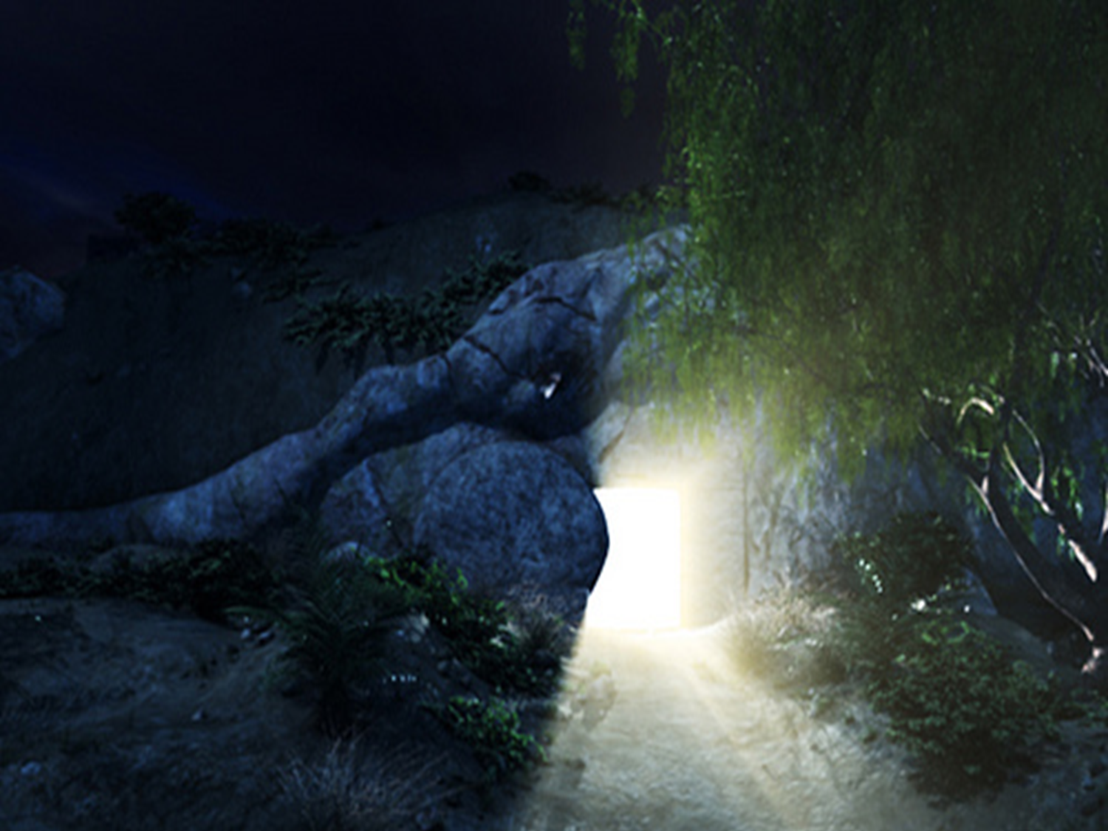
Isaiah 53
4 Surely He has borne our griefs
And carried our sorrows;
Yet we esteemed Him stricken,
Smitten by God, and afflicted.
5 But He was wounded for our transgressions,
He was bruised for our iniquities;
The chastisement for our peace was upon Him,
And by His stripes we are healed.
6 All we like sheep have gone astray;
We have turned, every one, to his own way;
And the LORD has laid on Him the iniquity of us all.

Slide 27
1 Corinthians 11
23 For I received from the Lord that which I also delivered to you: that the Lord Jesus on the same night in which He was betrayed took bread;
24 and when He had given thanks, He broke it and said, “Take, eat, this is My body which is broken for you; do this in remembrance of Me.” 25 In the same manner He also took the cup after supper, saying, “This cup is the new covenant in My blood. This do, as often as you drink it, in remembrance of Me.”
26 For as often as you eat this bread and drink this cup, you proclaim the Lord’s death till He comes.

Slide 28
372
“We Thank Thee, O Father”
“Now concerning the collection for the saints, as I have given orders to the churches of Galatia, so you must do also: 2 On the first day of the week let each one of you lay something aside, storing up as he may prosper, that there be no collections when I come.” – 1 Corinthians 16:1,2

Slide 29
“Lord, Send Me”

