Slide 2
“Bizarre
Christians”

Slide 3
“Bizarre Christians”
How does the world see you?
Have you ever been accused of being bizarre?
God’s people have often been misunderstood and sometimes criticized by society.

Slide 4
“Apostle Paul, Bizarre Disciple?”
“Therefore, having obtained help from God, to this day I stand, witnessing both to small and great, saying no other things than those which the prophets and Moses said would come — 23 that the Christ would suffer, that He would be the first to rise from the dead, and would proclaim light to the Jewish people and to the Gentiles.” Agrippa Parries Paul’s Challenge 24 Now as he thus made his defense, Festus said with a loud voice, “Paul, you are beside yourself! Much learning is driving you mad!” - Acts 26:22-24

Slide 5
“Apostle Paul, Bizarre Disciple?”
The word for “mad” here does not mean angry, but comes from the word from which we get the word “maniac”.
Festus was convinced that Paul was crazy.
God’s faithful servants have often been accused of being mad, or crazy.

Slide 6
“God’s Bizarre
People”

Slide 7
“God’s Bizarre People”
Does it bother you when other folks think you are bizarre for serving God?
Consider an account in 2 Kings 9…
Elisha sent one of the prophets to tell Jehu that he was to become the next king of Israel, and to anoint him.
When he arrived, Jehu was sitting among his military comrades (captains), and the prophet took into the house alone to tell him the news and anoint him.
Jehu returned to his friends, they ask Jehu, “Is all well? Why did this madman come to you?” (9:11)

Slide 8
“God’s Bizarre People”
“… soldiers like them very readily concluded such persons to be crack-brained, not only from the sordid negligence of their personal appearance, and their open contempt of the world, but from the religious pursuits in which their whole lives were spent,…”
(Jamieson, Fausset, and Brown Commentary)

Slide 9
“Jesus, Bizarre?”
His enemies accused him of being out of his mind.
“You have a demon” (John 7:20, marginal reading: “You are crazy.”)
”Say we not well that thou art a Samaritan, and hast a devil.” (John 8:48, marginal reading: “You are crazy.”)
John 8:52 - “Now we know that thou hast a devil.” (“You are crazy.”)
John 10:20 - “He has devil and is mad.” (“He is possessed of a demon and is crazy. “)
Even Jesus family questioned His mental stability. Mark 3:21 - When his family heard about this, they went to take charge of him, for they said, “He is out of his mind.”

Slide 10
2 Corinthians 5:13,14
“For if we are beside ourselves, it is for God; or if we are of sound mind, it is for you. 14 For the love of Christ compels us, because we judge thus: that if One died for all, then all died;”

Slide 11
“Characteristics
of Bizarre Christians”

Slide 12
“Single Focused Devotion”

Slide 13
“Single Focused Devotion”
God requires a single focused devotion, and it translates into a character that is misunderstood and criticized by the world.
“You mean you go to church services three times in a week?”
“You make your children miss sports or other activities for a Bible study?”
“You try to do everything the Bible says, no matter what?”

Slide 14
“Single Focused Devotion”
Paul was possessed with one great idea!
“For I was determined not to know anything among you, save Jesus Christ, and him crucified.” (1 Cor. 2:2)
Christ was possessed of one great propelling idea – to do His Father’s will!
“My meat is to do the will of him that sent me, and to finish his work.” (John 4:34.)

Slide 15
“Single Focused Devotion”
After clearing out the moneychangers from the temple, Jesus’ disciples were intrigued by this somewhat “dangerous” devotion to the cause.
“Then His disciples remembered that it was written, “Zeal for Your house has eaten Me up.” – John 2:17
“eaten Me up” means … Hath absorbed me, or engaged my entire attention and affection; hath surpassed all other feelings, so that it may be said to be the one great absorbing affection and desire of the mind. (Barnes)

Slide 16
“Other Worldly Pursuits”

Slide 17
“Other Worldly Pursuits”
If one makes decisions and sacrifices based upon spiritual goals and show little interest in getting ahead materially, they will call you “mad”.
In Acts 26 Festus had no way of embracing Paul’s value system and world perspective.
Why was he defending himself by talking about “heavenly visions” and repentance, and a resurrection?

Slide 18
“Other Worldly Pursuits”
If you talk about the Bible and Jesus when everybody else is talking about sports and the economy, they will think you are bizarre!
If you give up material gain to attain a spiritual goal, they will think you are “mad”!

Slide 19
“Other Worldly Pursuits”
Paul had no interest in worldly honors and material possessions.
“What things were gain to me, those I counted loss for Christ… for whom I have suffered the loss of all things, and do count them but nothing, that I may win Christ.” (Phil 3:7-8)

Slide 20
Matthew 4:8-10
“Again, the devil took Him up on an exceedingly high mountain, and showed Him all the kingdoms of the world and their glory. 9 And he said to Him, “All these things I will give You if You will fall down and worship me.” 10 Then Jesus said to him, “Away with you, Satan! For it is written, ‘You shall worship the Lord your God, and Him only you shall serve.’”

Slide 21
“Lack of Fear
& Intimidation”

Slide 22
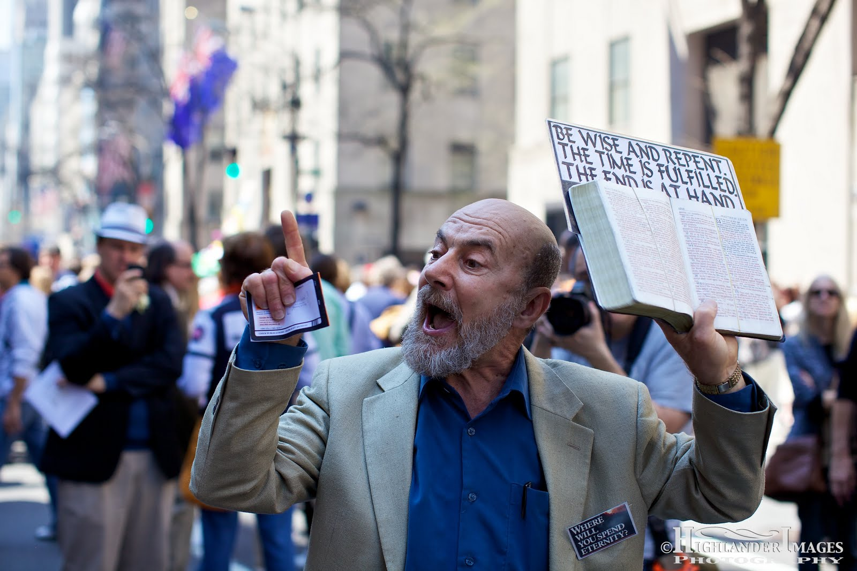
“Lack of Fear & Intimidation”
Have you ever seen the fellow on the street preaching that the end is near?
What is your first assessment? Maybe bizarre?
Not just because you do not think he is right about the end of time (specified date/time), but because he is preaching fearlessly in the streets.

Slide 23
“Lack of Fear & Intimidation”
God’s people have often been considered crazy because they are not afraid to be different.
Crazy David walked fearlessly out to face a giant of a man. Doesn’t he know what is going to happen to him?
Elijah faced 450 prophets of Baal on Mt. Carmel
Daniel’s 3 friends defiantly refused to obey the king’s orders (that’s crazy; somebody needs to talk to them)
As a defenseless old man Daniel prayed to God with his window open so that all his enemies could see.

Slide 24
2 Timothy 1:6-8
“Therefore I remind you to stir up the gift of God which is in you through the laying on of my hands. 7 For God has not given us a spirit of fear, but of power and of love and of a sound mind. Not Ashamed of the Gospel 8 Therefore do not be ashamed of the testimony of our Lord, nor of me His prisoner, but share with me in the sufferings for the gospel according to the power of God,”

Slide 25
“A Call
to Madness”

Slide 26
“A Call To Madness”
Jesus characterized the worldly, disobedient person as blind, as sheep without a shepherd, foolishly going down a road to self-destruction.
Who is really mad?
If I choose to follow Christ and I am wrong about everything I believe (there is not God, salvation or judgment) in the end what have I lost?
But if I ignore God and His word, and I am wrong about it, what do I lose in the end? (That’s Insane!)

Slide 27
“Conclusion”

Slide 28
Conclusion
Sometimes being called bizarre, crazy, strange, insane, mad means you are sanest of all.
It may mean you belong to God.
A people who are obsessed with the one idea of doing God’s will. (Matt. 6:33; Luke 9:23)
A people who are characterized by burning zeal and devotion.
A people who seek the spiritual over the physical.

Slide 29
2 Corinthians 4:16-18
“Therefore we do not lose heart. Even though our outward man is perishing, yet the inward man is being renewed day by day. 17 For our light affliction, which is but for a moment, is working for us a far more exceeding and eternal weight of glory, 18 while we do not look at the things which are seen, but at the things which are not seen. For the things which are seen are temporary, but the things which are not seen are eternal.”

Slide 30
Conclusion
It may mean you belong to God.
A people who are obsessed with the one idea of doing God’s will. (Matt. 6:33; Luke 9:23)
A people who are characterized by burning zeal and devotion.
A people who seek the spiritual over the physical.
A people who have no fear of being different—in fashion, in speech, in conduct, in religion. (1 Pet. 2:9)
A people who speak strange things, the Gospel. (Mark 16:16; Acts 2: 38; 1 Pet. 3:21)
“Are you ‘mad’
for God?”

Slide 31
“Bizarre
Christians”

