Slide 2
“A Great Gift!”
It is a great gift from God to be able to come before Him in song and poem, to express in melodies deeper than human words the anguish of loss, the peace of prayer, and the joy of salvation.

Slide 3
Exodus 15:1
Then Moses and the children of Israel sang this song to the Lord, and spoke, saying:
“I will sing to the Lord,
For He has triumphed gloriously!
The horse and its rider
He has thrown into the sea!

Slide 4
Exodus 15:2
“The Lord is my strength and song, And He has become my salvation; He is my God, and I will praise Him; My father’s God, and I will exalt Him.”

Slide 5
452
“He Keeps Me Singing”

Slide 6
1 Cor. 14:15
“I shall pray with the spirit and I shall pray with the mind also; I shall sing with the spirit and I shall sing with the mind also.”

Slide 7
Col. 3:16
“Let the word of Christ richly dwell within you, with all wisdom teaching and admonishing one another with psalms, hymns, and spiritual songs, singing with thankfulness in your hearts to God”

Slide 8
626
“It Is Well
With My Soul”

Slide 9
“It Is Well With My Soul”
Music composed by Philip Bliss, 1876
In 1874, a French steam liner, the “Ville de Havre,” was on its way back to France from America, with a large number of passengers.

Slide 10
“On board the steamer was a Mrs. Spafford, with her four children. In mid-ocean a collision took place with a large sailing vessel, causing the steamer to sink in half an hour. Nearly all on board were lost. Mrs. Spafford got her children out of their berths and up on the deck. On being told that the vessel would soon sink, she knelt down with her children in prayer, asking God that they might be saved if possible; or be made willing to die, if that was his will. In a few minutes the vessel sank to the bottom of the sea, and the children were lost. One of the sailors. . . found Mrs. Spafford floating in the water” (My Life And The Story Of The Gospel Hymns, Sankey, 190).

Slide 11
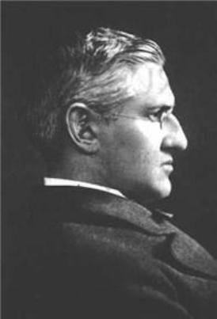
“It Is Well With My Soul”
Mr. Spafford soon received a wire message from his wife in England, which simply read, “Saved alone.”
Only because of his faith in God was he able to write, “When sorrows like sea billows roll. . . it is well with my soul.”

Slide 12
“It Is Well With My Soul”
God causes “all things to work together for good to those who love God” (Romans 8:28).
God is in control.
“I returned and saw under the sun that—The race is not to the swift, Nor the battle to the strong, Nor bread to the wise, Nor riches to men of understanding, Nor favor to men of skill; But time and chance happen to them all.” – Eccl. 9:11

Slide 13
Lamentations 3:38
“Is it not from the mouth of the Most High that woe and well-being proceed?”

Slide 14
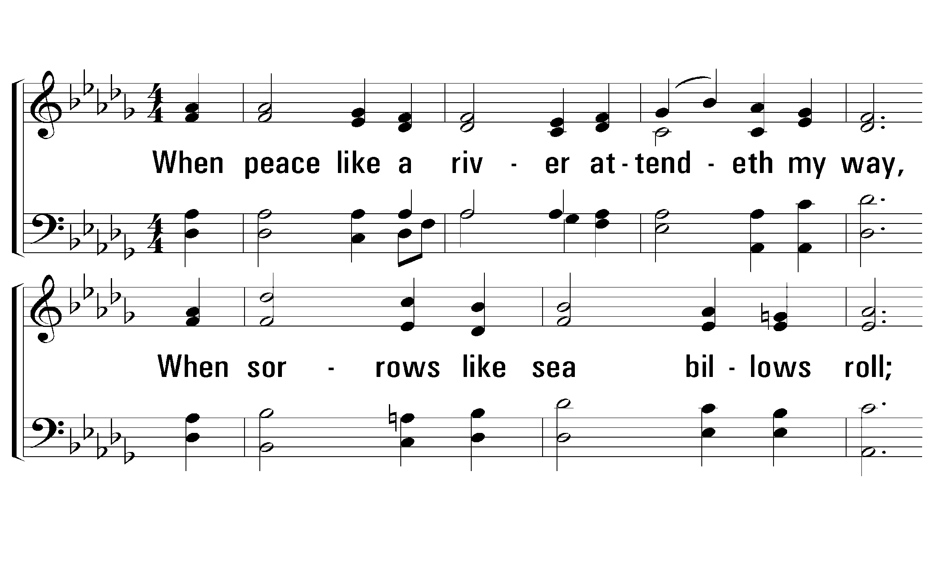
1 - It Is Well With My Soul
1.
When peace like a river attendeth my way,
When sorrows like sea billows roll;
Whatever my lot, Thou hast taught me to say,
"It is well, it is well with my soul."
Words by: H. G. Spafford
Music by: P. P. Bliss
© 2001 The Paperless Hymnal™

Slide 15
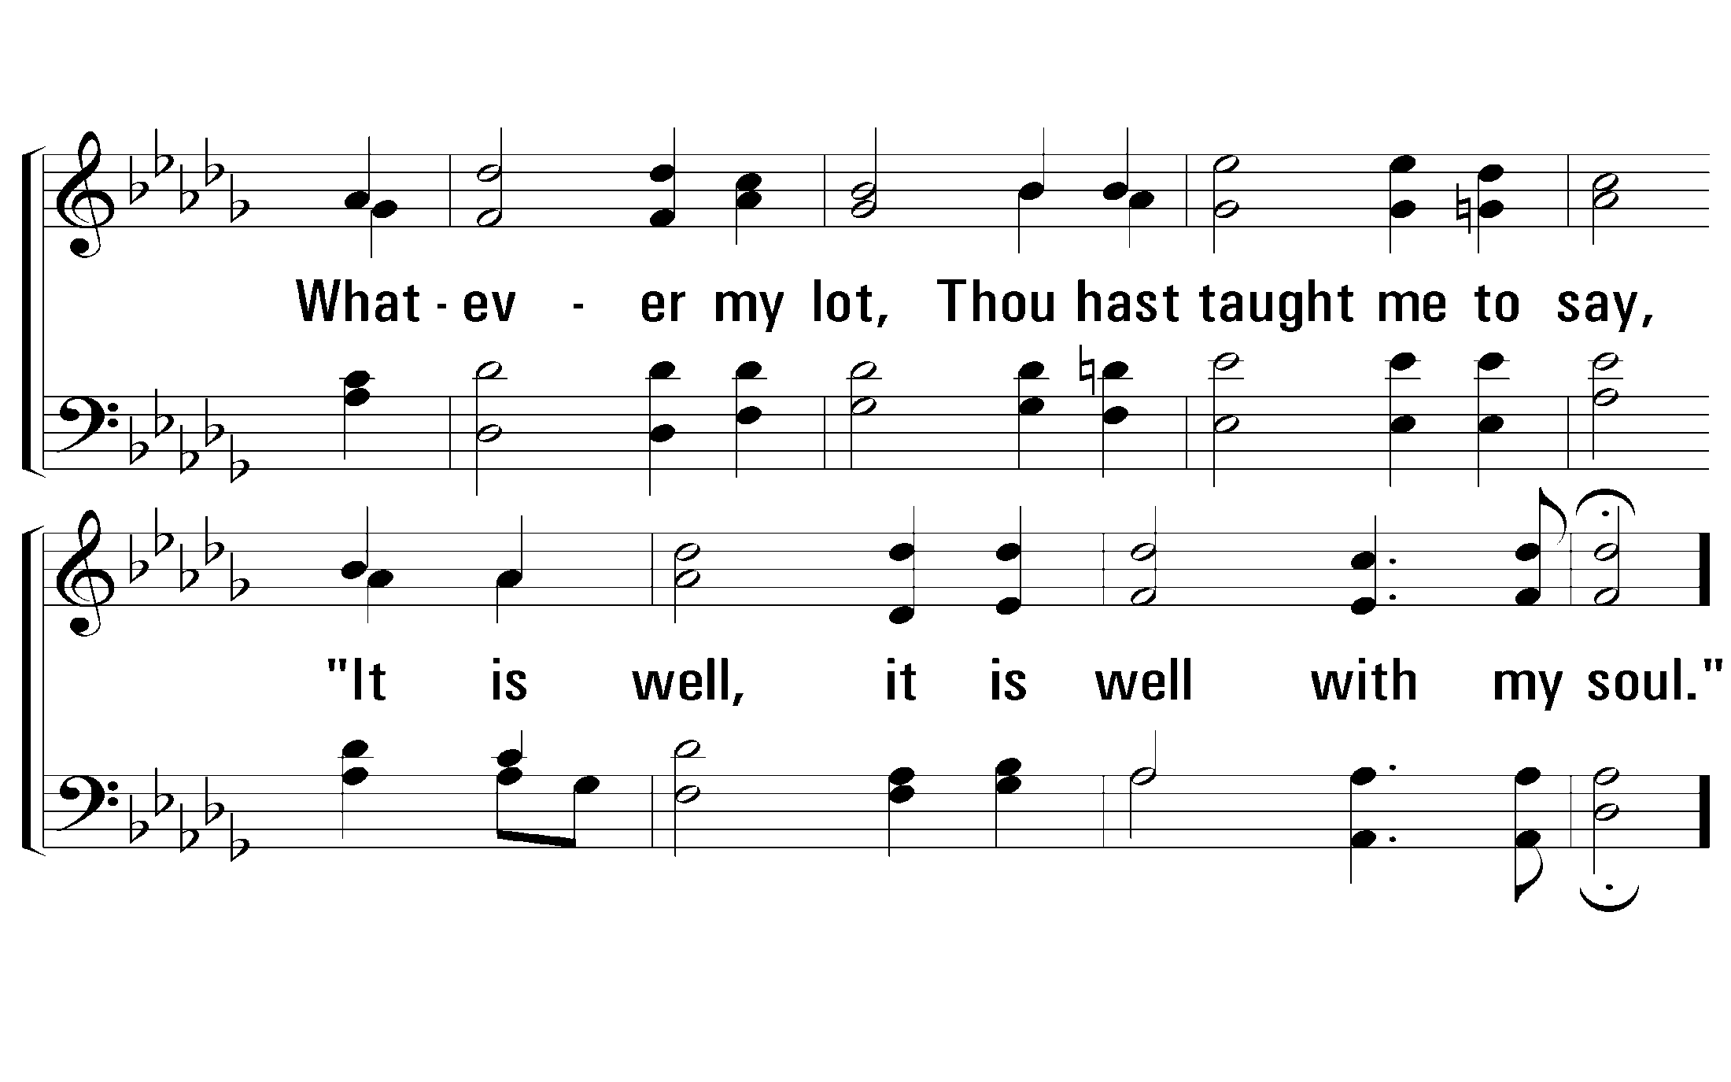
1 - It Is Well With My Soul
© 2001 The Paperless Hymnal™

Slide 16
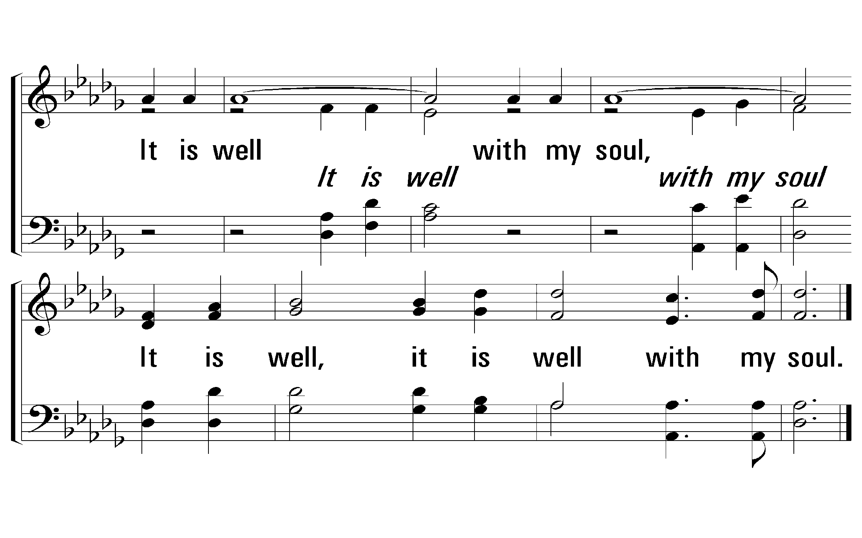
c - It Is Well With My Soul
It is well with my soul,
It is well, it is well with my soul.
© 2001 The Paperless Hymnal™

Slide 17
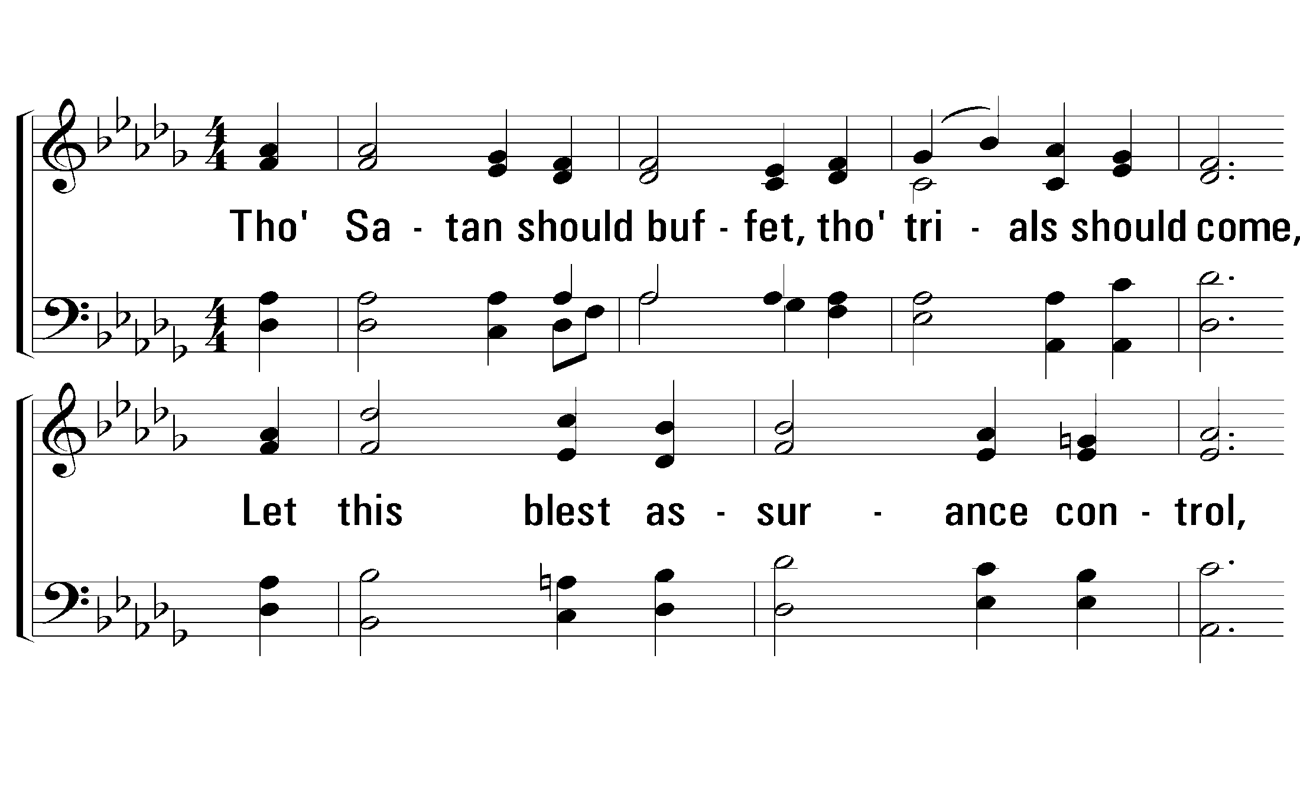
2 - It Is Well With My Soul
2.
Though Satan should buffet, though trials should come,
Let this blest assurance control,
That Christ hath regarded my helpless estate,
And hath shed His own blood for my soul.
Words by: H. G. Spafford
Music by: P. P. Bliss
© 2001 The Paperless Hymnal™

Slide 18
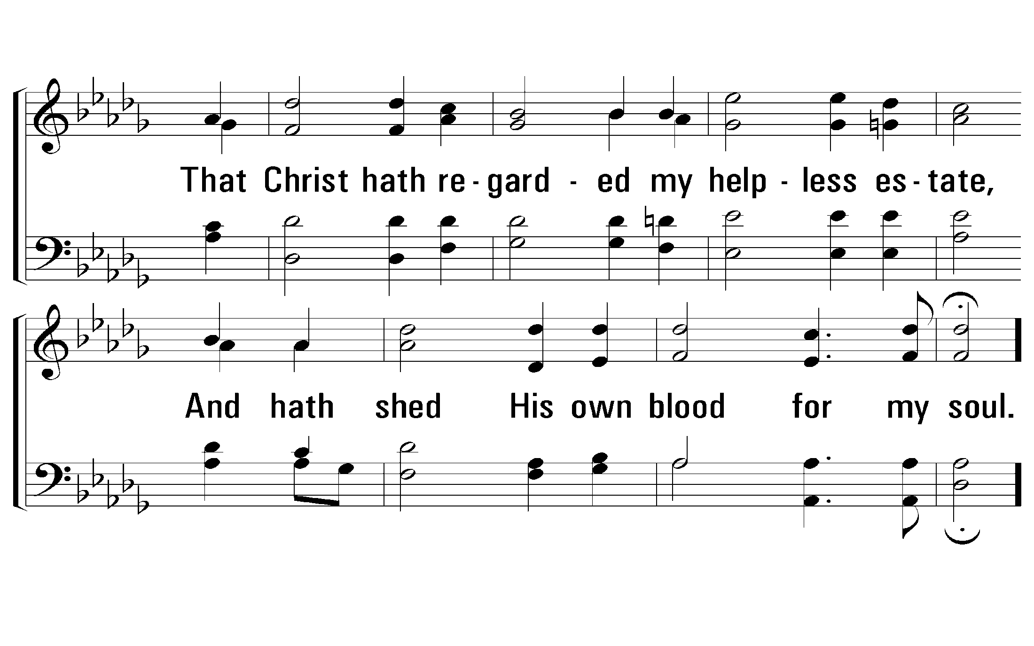
2 - It Is Well With My Soul
© 2001 The Paperless Hymnal™

Slide 19
c - It Is Well With My Soul
It is well with my soul,
It is well, it is well with my soul.
© 2001 The Paperless Hymnal™

Slide 20
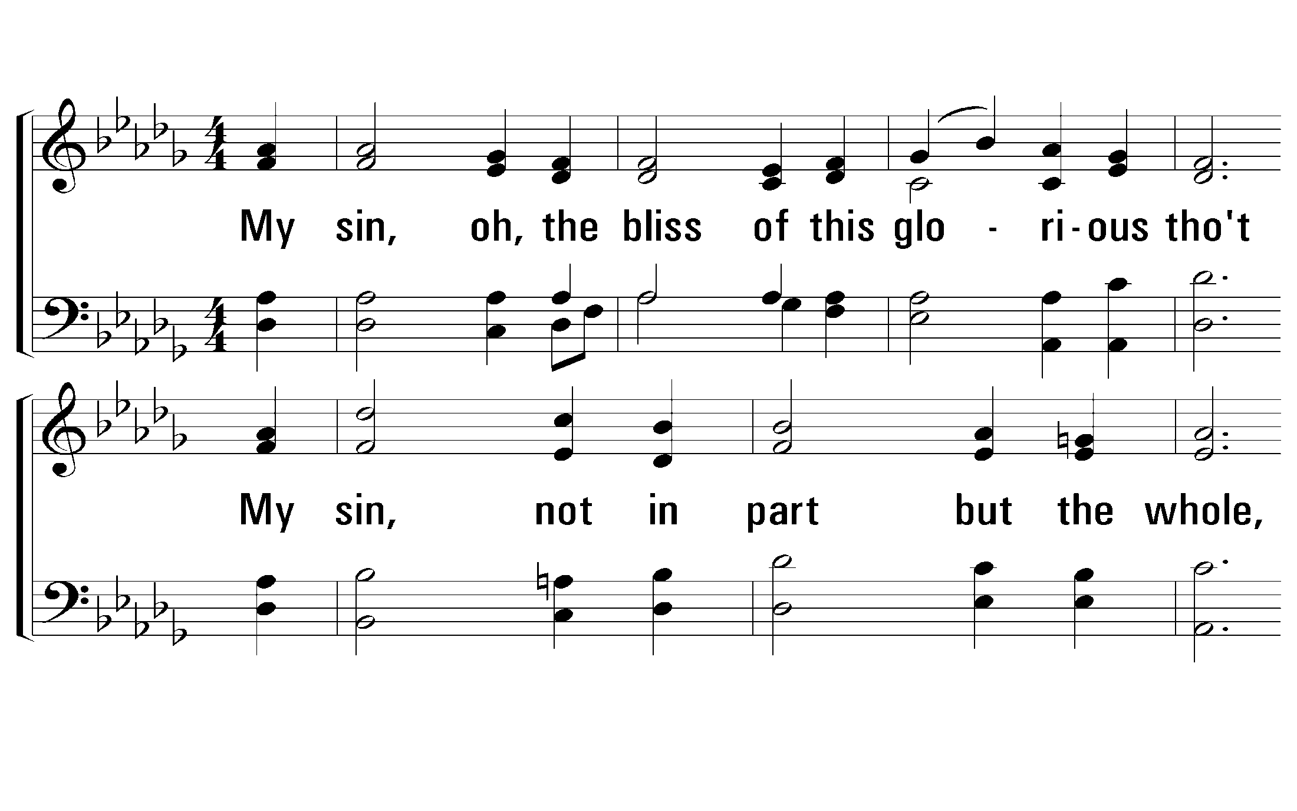
3 - It Is Well With My Soul
3.
My sin, oh, the bliss of this glorious thought
My sin, not in part but the whole,
Is nailed to the cross and I bear it no more:
Praise the Lord, praise the Lord, O my soul!
Words by: H. G. Spafford
Music by: P. P. Bliss
© 2001 The Paperless Hymnal™

Slide 21
3 - It Is Well With My Soul
© 2001 The Paperless Hymnal™

Slide 22
c - It Is Well With My Soul
It is well with my soul,
It is well, it is well with my soul.
© 2001 The Paperless Hymnal™

Slide 23
4 - It Is Well With My Soul
4.
And, Lord, haste the day when the faith shall be sight,
The clouds be rolled back as a scroll,
The trump shall resound and the Lord shall descend,
"Even so" it is well with my soul.
Words by: H. G. Spafford
Music by: P. P. Bliss
© 2001 The Paperless Hymnal™

Slide 24
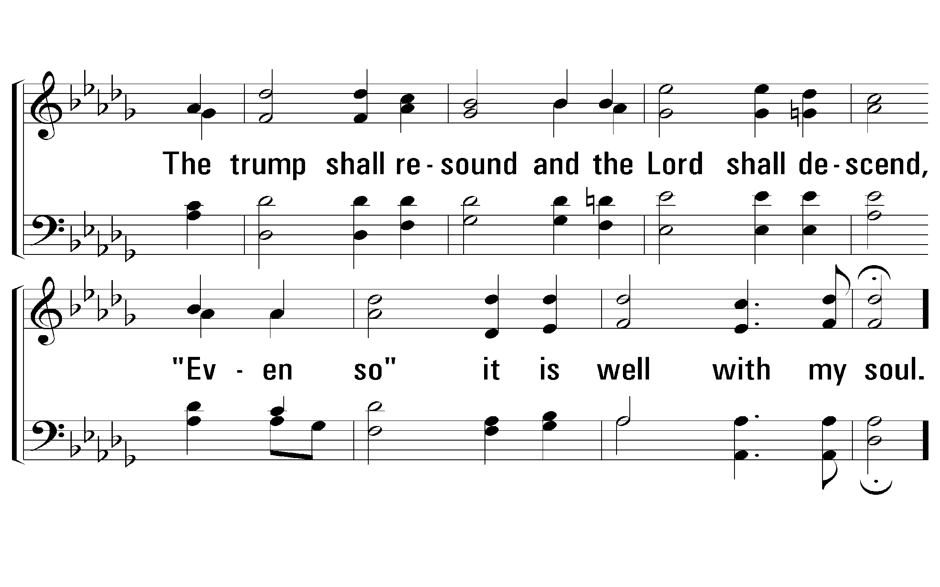
4 - It Is Well With My Soul
© 2001 The Paperless Hymnal™

Slide 25
c - It Is Well With My Soul
It is well with my soul,
It is well, it is well with my soul.
© 2001 The Paperless Hymnal™

Slide 26
Psalm 37:23,24
“The steps of a man are established by the Lord; and He delights in his way. When he falls, he shall not be hurled headlong; because the Lord is the One who holds his hand.”

Slide 27
Handout
“Hold My Hand”

Slide 28
69
“What A Friend
We Have In Jesus”

Slide 29
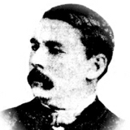
“What A Friend We Have In Jesus”
Written by Joseph Scriven, 1855
Scriven was born in 1819 in Dublin, and moved to Canada at the age of twenty-five. He was born into a wealthy family, received a fine education, and was even ready to be married. But on the eve of his wedding, Scriven’s fiancée drowned.

Slide 30
“One afternoon he was seen walking down the streets of Port Hope, where he lived, dressed as a plain workingman and carrying a saw horse and a saw on his mission of help. A citizen, noticing that a friend recognized him, said: ‘Do you know that man? What is his name and where does he live? I want some one to cut wood and I find it difficult to get a sober man to do the work faithfully.’ ‘But you can’t get that man,’ was the reply. ‘That is Mr. Scriven. He won’t cut wood for you.’ ‘Why not?’ queried the gentleman. ‘Because you are able to pay for it. He only saws wood for poor widows and sick people’” (Sankey, 334).

Slide 31
“Being Friends With The Savior”
First, we need to come to an understanding of the kind of friend that Christ is to all of us. Rom. 5:6-8
Being obedient to Christ.
“Greater love has no man than this, that he lay down his life for his friends. You are my friends if you do what I command you.” – Jn 15:14

Slide 32
“Being Friends With The Savior”
Finally, once we have made our lives right with God we need to extend the same friendship to our brethren.
“Beloved, if God so loved us, we also ought to love one another” (1 Jn 4:11).

Slide 33
1 – What a Friend We Have In Jesus
1.
What a Friend we have in Jesus,
All our sins and griefs to bear;
What a privilege to carry
Everything to God in prayer.
O what peace we often forfeit,
O what needless pain we bear,
All because we do not carry
Everything to God in prayer.
Words: Joseph Scriven
Music: Charles C. Converse
© 2002 The Paperless Hymnal™

Slide 34
1 – What a Friend We Have In Jesus
© 2002 The Paperless Hymnal™

Slide 35
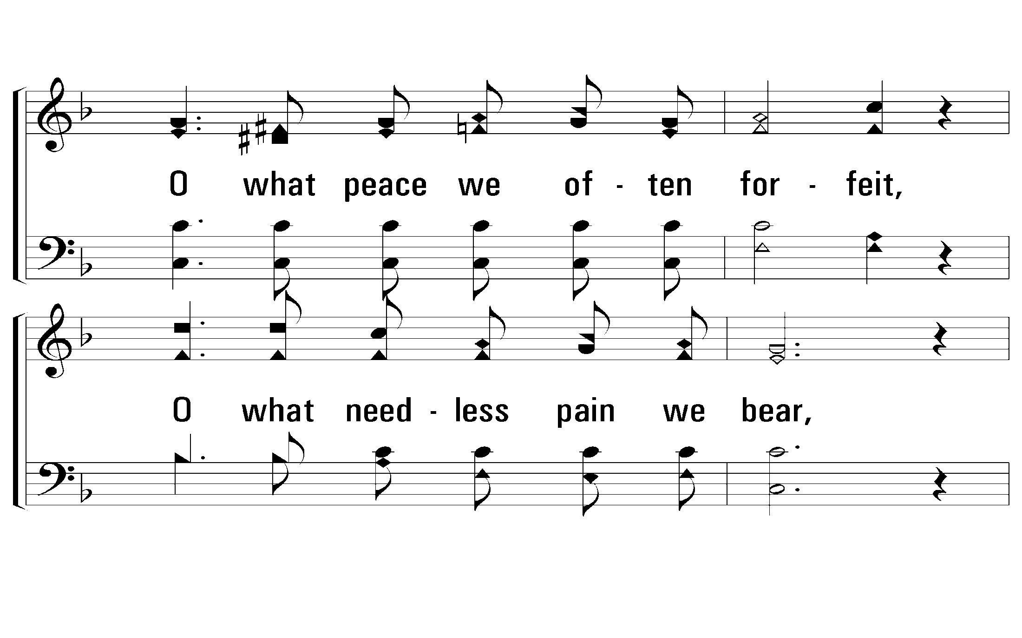
1 – What a Friend We Have In Jesus
© 2002 The Paperless Hymnal™

Slide 36
1 – What a Friend We Have In Jesus
© 2002 The Paperless Hymnal™

Slide 37
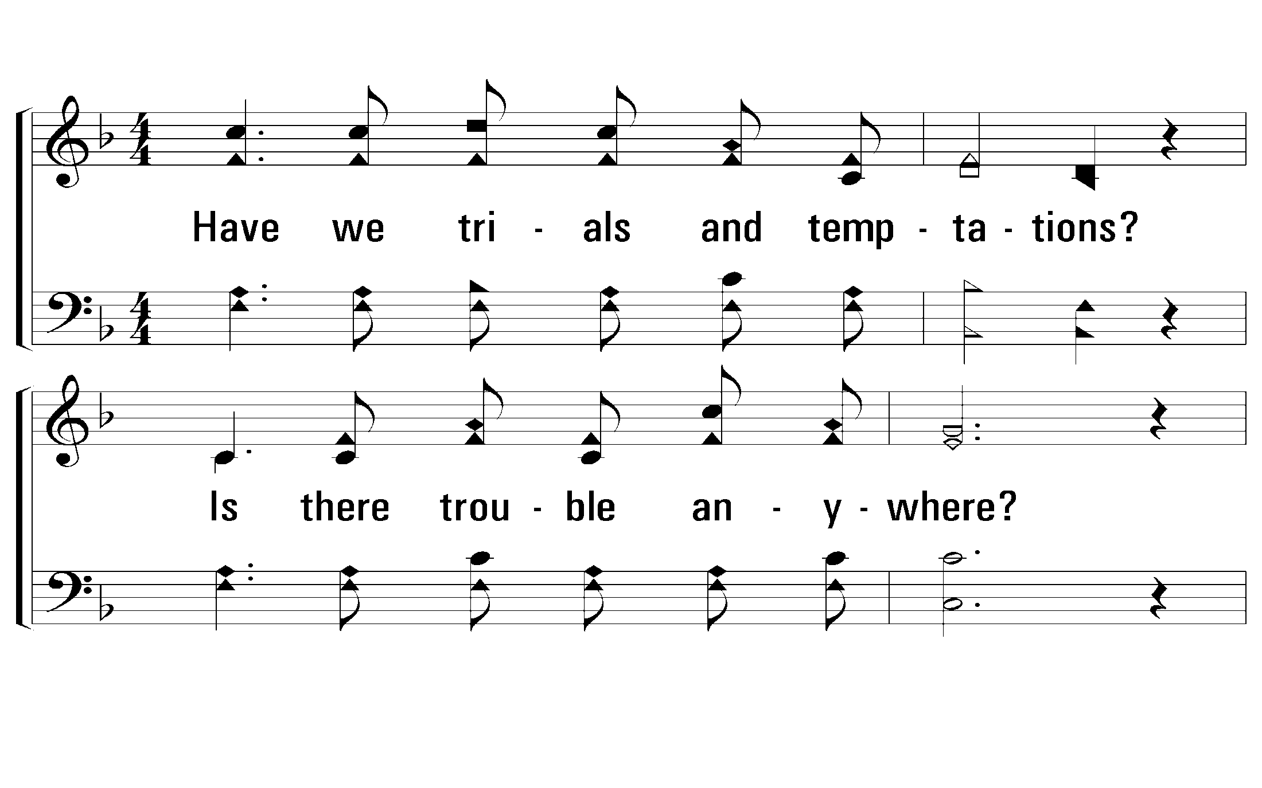
2 – What a Friend We Have In Jesus
2.
Have we trials and temptations?
Is there trouble anywhere?
We should never be discouraged,
Take it to the Lord in prayer.
Can we find a friend so faithful,
Who will all our sorrows share?
Jesus knows our every weakness:
Take it to the Lord in prayer.
Words: Joseph Scriven
Music: Charles C. Converse
© 2002 The Paperless Hymnal™

Slide 38
2 – What a Friend We Have In Jesus
© 2002 The Paperless Hymnal™

Slide 39
2 – What a Friend We Have In Jesus
© 2002 The Paperless Hymnal™

Slide 40
2 – What a Friend We Have In Jesus
© 2002 The Paperless Hymnal™

Slide 41
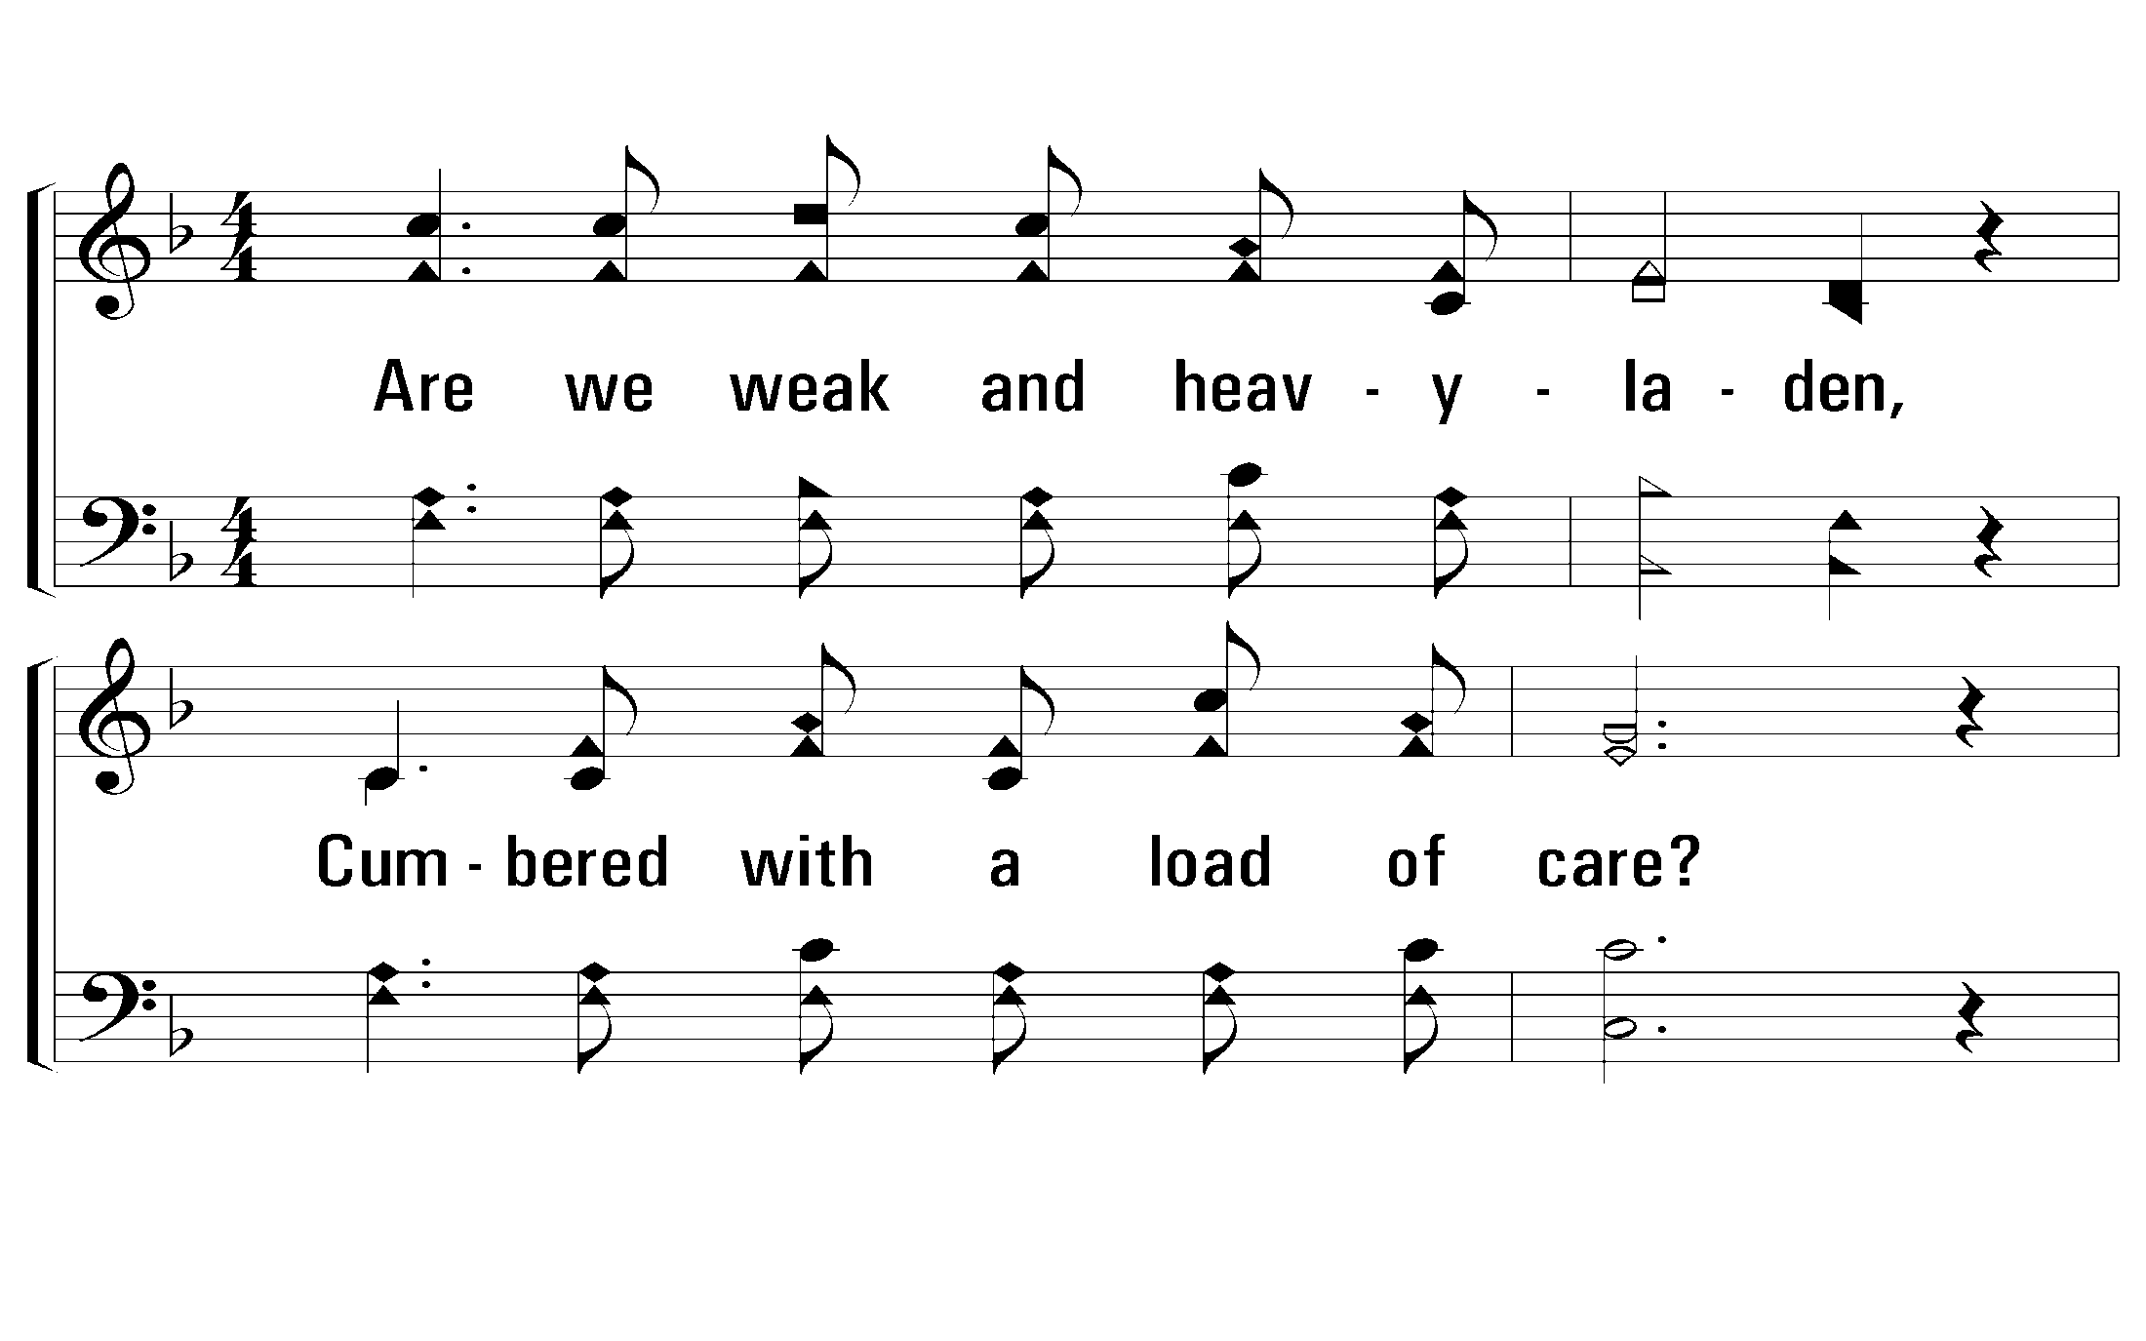
3 – What a Friend We Have In Jesus
3.
Are we weak and heavy-laden,
Cumbered with a load of care?
Precious Savior, still our refuge,
Take it to the Lord in prayer.
Do thy friends despise, forsake thee?
Take it to the Lord in prayer;
In His arms He'll take and shield thee,
Thou wilt find a solace there.
Words: Joseph Scriven
Music: Charles C. Converse
© 2002 The Paperless Hymnal™

Slide 42
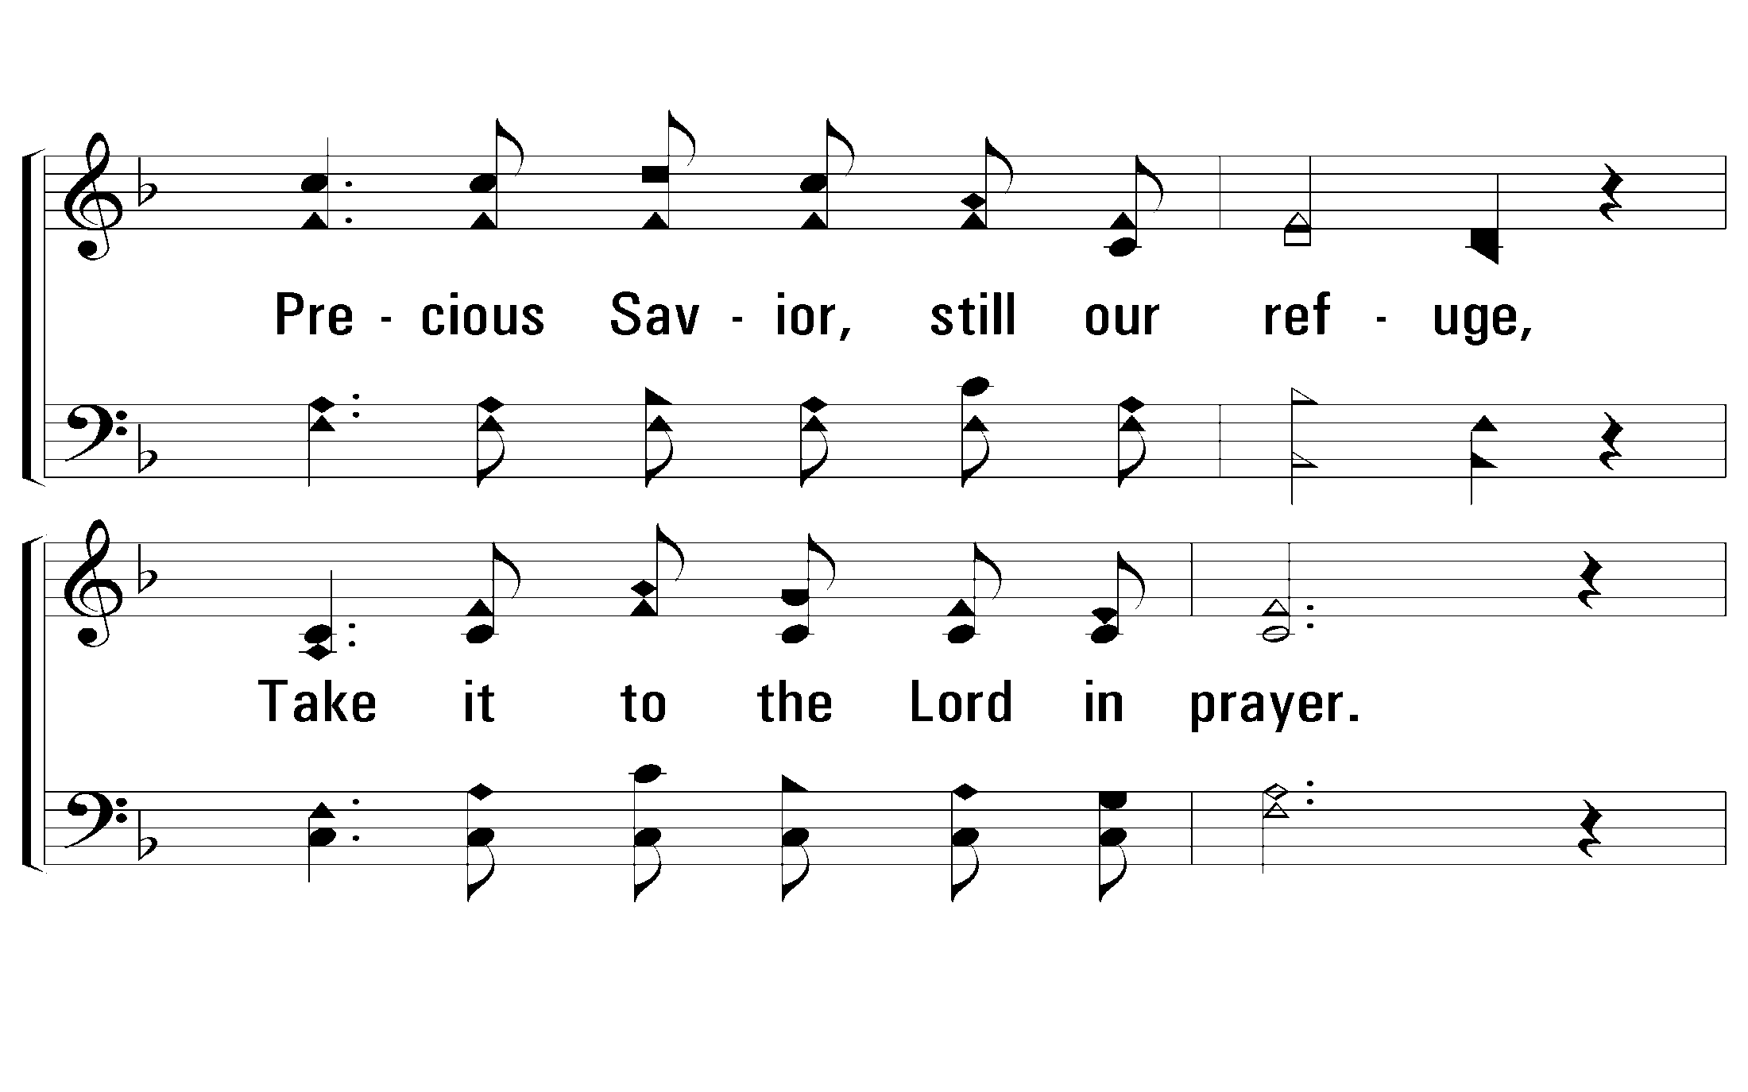
3 – What a Friend We Have In Jesus
© 2002 The Paperless Hymnal™

Slide 43
3 – What a Friend We Have In Jesus
© 2002 The Paperless Hymnal™

Slide 44
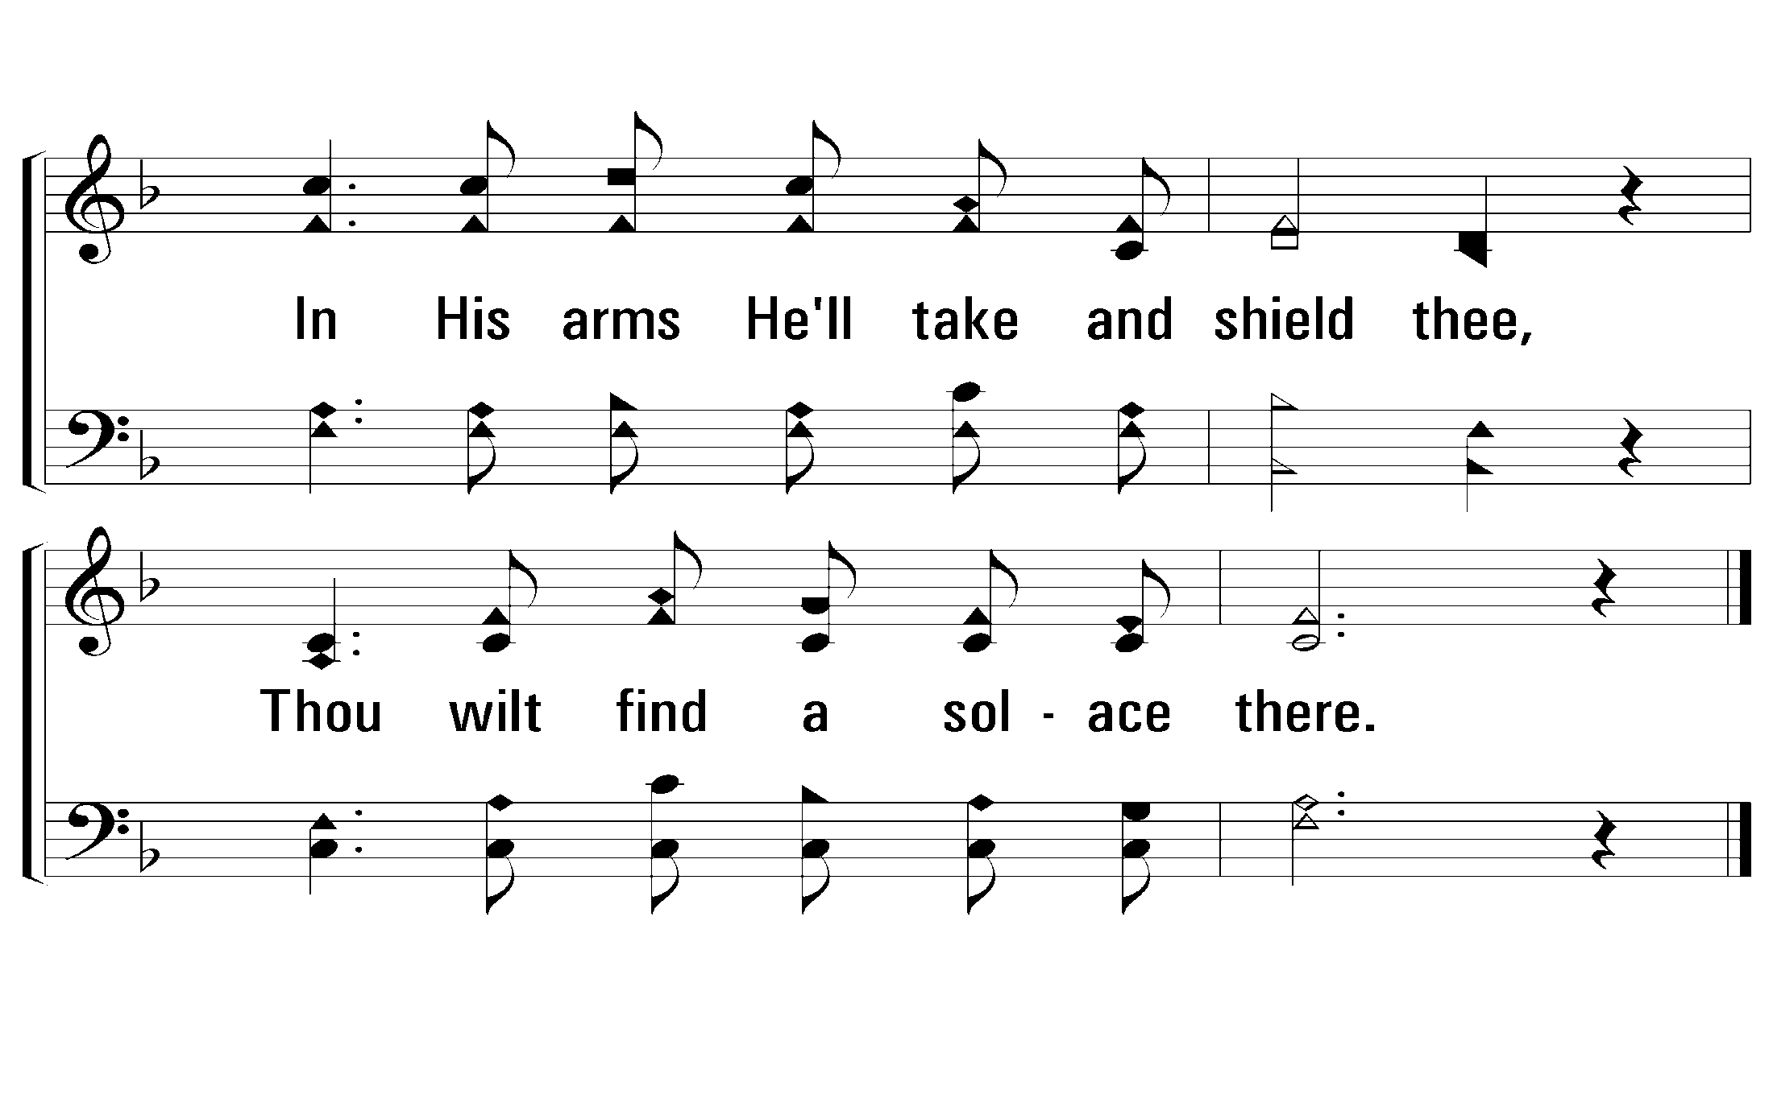
3 – What a Friend We Have In Jesus
© 2002 The Paperless Hymnal™

Slide 45
2 Cor. 8:9
“For you know the grace of our Lord Jesus Christ, that though He was rich, yet for your sake He became poor, that you through His poverty might become rich”

Slide 46
594
“The Lily Of
The Valley”

Slide 47
330
“Just As I Am”

Slide 48
1 John 1:8-10
“If we say that we have no sin, we are deceiving ourselves, and the truth is not in us. If we confess our sins, He is faithful and righteous to forgive us our sins and cleanse us from all unrighteousness. If we say that we have not sinned, we make Him a liar, and His word is not in us”

Slide 49
Colossians 1:21,22
“And you, who once were alienated and enemies in your mind by wicked works, yet now He has reconciled 22 in the body of His flesh through death, to present you holy, and blameless, and above reproach in His sight—”

Slide 50
“During a service of song. . . John B. Gough was asked by a man in the pew with him what was to be sung, as the announcement had not been heard. The questioner was most repulsive in appearance, because of a nervous disease that disfigured his face and form. When the singing began, Gough was driven almost to frenzy by the harsh and discordant tones of the singer by his side. But when they came to “Just as I am, poor, wretched, blind,” the wretched creature lifted his sightless eyes to heaven and sang with his whole soul. [Gough] said, “I have heard the finest strains of orchestra, choir, and soloist this world can produce, but I never heard music until I heard that blind man sing, ‘O, Lamb of God, I come, I come’”” (Sankey, 209).

