Slide 1
237 – Let The Lower Lights Be Burning
Handout – Beautiful Star Of Bethlehem
Opening Prayer
369 – Mended And Whole
372 – We Thank Thee, O Father
453 – Ye Are The Light Of The World
Sermon
470 – Do You Know My Jesus?
361 – In His Time

Slide 2
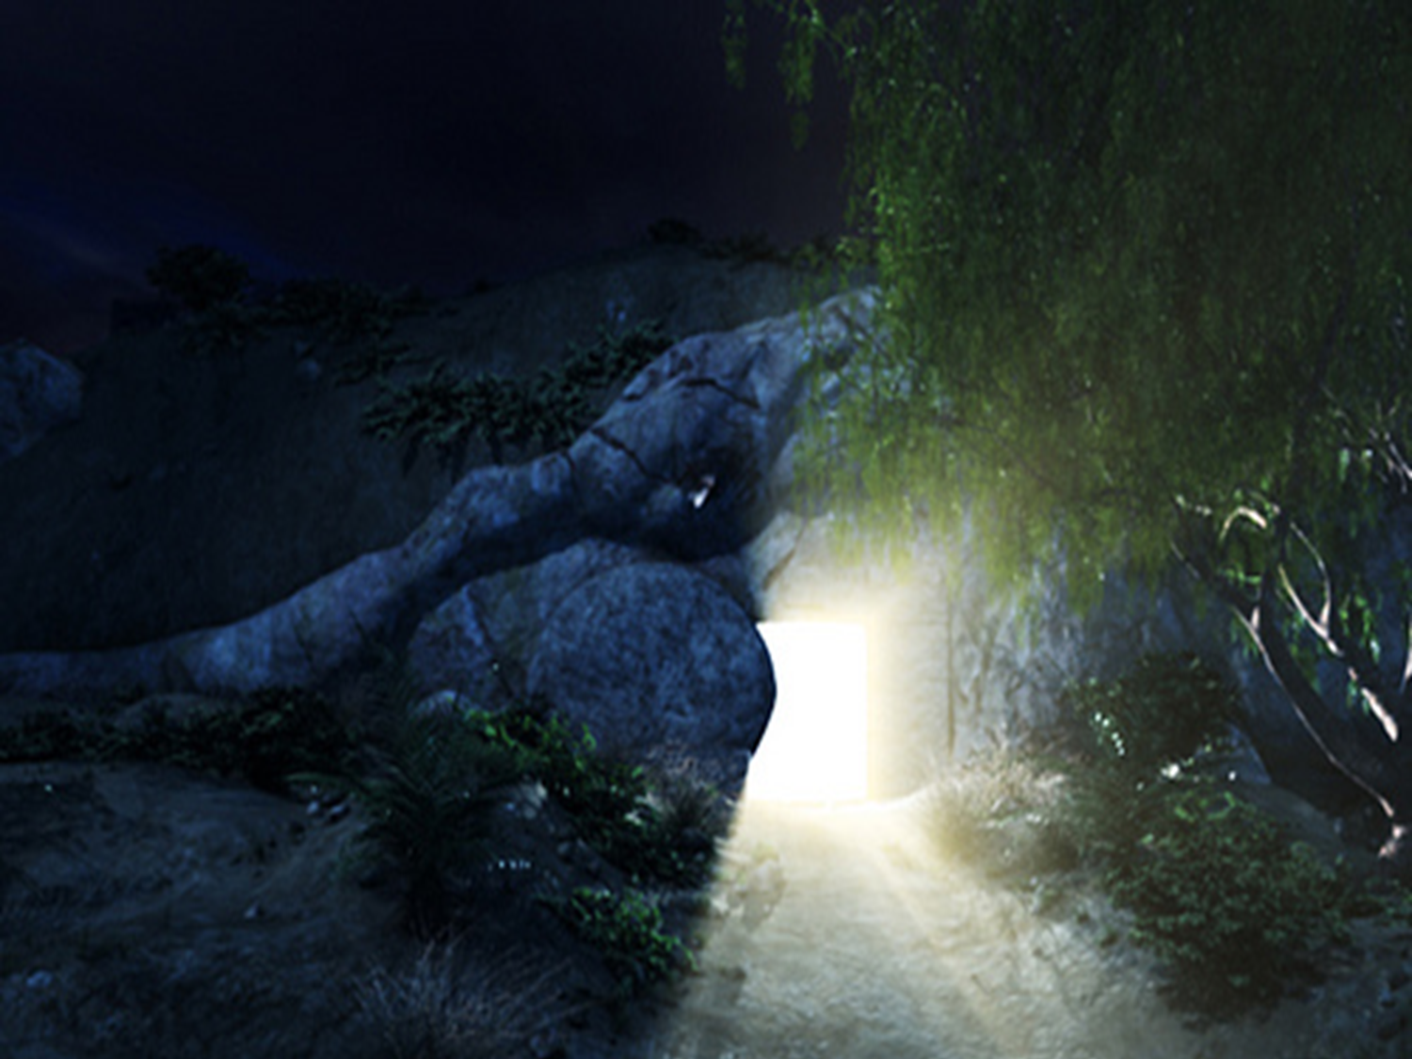
Isaiah 53
4 Surely He has borne our griefs
And carried our sorrows;
Yet we esteemed Him stricken,
Smitten by God, and afflicted.
5 But He was wounded for our transgressions,
He was bruised for our iniquities;
The chastisement for our peace was upon Him,
And by His stripes we are healed.
6 All we like sheep have gone astray;
We have turned, every one, to his own way;
And the LORD has laid on Him the iniquity of us all.

Slide 3
1 Corinthians 11
23 For I received from the Lord that which I also delivered to you: that the Lord Jesus on the same night in which He was betrayed took bread;
24 and when He had given thanks, He broke it and said, “Take, eat, this is My body which is broken for you; do this in remembrance of Me.” 25 In the same manner He also took the cup after supper, saying, “This cup is the new covenant in My blood. This do, as often as you drink it, in remembrance of Me.”
26 For as often as you eat this bread and drink this cup, you proclaim the Lord’s death till He comes.

Slide 4
237 – Let The Lower Lights Be Burning
Handout – Beautiful Star Of Bethlehem
Opening Prayer
369 – Mended And Whole
372 – We Thank Thee, O Father
453 – Ye Are The Light Of The World
Sermon
470 – Do You Know My Jesus?
361 – In His Time

Slide 5
“Am I A Beacon?”

Slide 6
Philippians 2:14-16
“Do all things without complaining and disputing, 15 that you may become blameless and harmless, children of God without fault in the midst of a crooked and perverse generation, among whom you shine as lights in the world, 16 holding fast the word of life, so that I may rejoice in the day of Christ that I have not run in vain or labored in vain.”

Slide 7
Why Is This Question Important?
“to the weak I became as weak, that I might win the weak. I have become all things to all men, that I might by all means save some.” – 1 Cor. 9:22
The goal of his labor was salvation for those whom he served.
“Am I A Beacon?”

Slide 8
“Being A Beacon”

Slide 9
“Being A Beacon”
The light does NOT originate with us.
Jesus Is The Light!
“Then Jesus spoke to them again, saying, “I am the light of the world. He who follows Me shall not walk in darkness, but have the light of life.” – Jn 8:12
“I have come as a light into the world, that whoever believes in Me should not abide in darkness.” – Jn 12:46

Slide 10
John 1:1-4
“In the beginning was the Word, and the Word was with God, and the Word was God. 2 He was in the beginning with God. 3 All things were made through Him, and without Him nothing was made that was made. 4 In Him was life, and the life was the light of men.”

Slide 11
“Being A Beacon”
If we are going to be beacons, we must reflect the light that shines from Jesus.
Only then can we guide anyone to heaven.
“Your word is a lamp to my feet, and a light to my path.” – Psalm 119:105
Philippians 2:16 says we shine our light when we hold fast to the word.
We cannot possibly reflect Jesus’ light unless we are reflecting the words Jesus recorded.

Slide 12
“When Are We Beacons?”
When we reflect the light of Jesus to the world by walking in Christ’s Word so the world can follow us to heaven.
“Brethren, join in following my example, and note those who so walk, as you have us for a pattern.” – Phil. 3:17
“The things which you learned and received and heard and saw in me, these do, and the God of peace will be with you.” – Phil. 4:9

Slide 13
“Am I A Beacon?”

Slide 14
“Am I Doing This In The Name Of The Lord?”

Slide 15
Colossians 3:17
“And whatever you do in word or deed, do all in the name of the Lord Jesus, giving thanks to God the Father through Him.”

Slide 16
A Question Of Authority
If Jesus were right here next to us, could we say, “I’m doing this with Your permission and blessing”?
Can you go where you are going in Jesus’ name?
Can you do what you are doing in Jesus’ name?
As a congregation, if Jesus were sitting here could we say we are doing what we are doing in Jesus’ name?
Can we go to the book, chapter and verse to show where He has empowered us to act, worship and work in this way?

Slide 17
“Am I Surrendering
To God?”

Slide 18
Luke 14:25-33
“Now great multitudes went with Him. And He turned and said to them, 26 “If anyone comes to Me and does not hate his father and mother, wife and children, brothers and sisters, yes, and his own life also, he cannot be My disciple. 27 And whoever does not bear his cross and come after Me cannot be My disciple. 28 For which of you, intending to build a tower, does not sit down first and count the cost, whether he has enough to finish it”

Slide 19
Luke 14:25-33
29 lest, after he has laid the foundation, and is not able to finish, all who see it begin to mock him, 30 saying, ‘This man began to build and was not able to finish’? 31 Or what king, going to make war against another king, does not sit down first and consider whether he is able with ten thousand to meet him who comes against him with twenty thousand? 32 Or else, while the other is still a great way off, he sends a delegation and asks conditions of peace. 33 So likewise, whoever of you does not forsake all that he has cannot be My disciple.”

Slide 20
A Question Of Lordship
It means carrying a cross.
It means surrendering our all to Jesus.
“If your right eye causes you to sin, pluck it out and cast it from you; for it is more profitable for you that one of your members perish, than for your whole body to be cast into hell.” Matthew 5:29

Slide 21
Galatians 2:20
“I have been crucified with Christ; it is no longer I who live, but Christ lives in me; and the life which I now live in the flesh I live by faith in the Son of God, who loved me and gave Himself for me.”

Slide 22
Romans 12:1
“I beseech you therefore, brethren, by the mercies of God, that you present your bodies a living sacrifice, holy, acceptable to God, which is your reasonable service.”

Slide 23
A Question Of Lordship
In my actions, who is actually being Lord?
Who is governing this and making this choice?
Is it me? Or is it Jesus?
Who is in charge of my life right now?

Slide 24
“Am I
Glorifying God?”

Slide 25
Matthew 5:16
“Let your light so shine before men, that they may see your good works and glorify your Father in heaven.”

Slide 26
Matthew 6:1
“Take heed that you do not do your charitable deeds before men, to be seen by them. Otherwise you have no reward from your Father in heaven.”

Slide 27
A Question Of Goals
Are we trying to glorify God or receive our own praise?
Why am I preaching this sermon?
Why are you leading that prayer?
Why are you being a song leader?
Why are you writing that check?
Who are you trying to glorify?
Whose reputation are we trying to increase?
What goals are we pursuing?

Slide 28
“Am I
Cheerful
About It?”

Slide 29
Philippians 2:14
“Do all things without complaining and disputing,”

Slide 30
A Question Of Attitude
The point is that we should be cheerful about being a beacon.
What is my attitude as I answer all the other questions?
Am I doing these things cheerfully because I know this is where God is and this is where life through God’s grace is?

Slide 31
“Am I
Standing Out?”

Slide 32
Romans 12:2
“And do not be conformed to this world, but be transformed by the renewing of your mind, that you may prove what is that good and acceptable and perfect will of God.”

Slide 33
A Question Of Commitment
“But you are a chosen generation, a royal priesthood, a holy nation, His own special people, that you may proclaim the praises of Him who called you out of darkness into His marvelous light” – 1 Peter 2:9
Are we willing to stay the course when people begin to ridicule us because we are not like them?
Joshua 24:15 “As for me and my house, we will serve the Lord”

Slide 34
“Am I A Beacon?”

